Slide 1

PROJECT DEFINATION:-
BEAUTY CARE
LET’S START

Slide 2

Submitted by: -
Name | Roll no
Ravi Mavar | 175490686017
Submitted To: -
R B Institute Of Management Studies (RBIMS)

Slide 3
INTRODUCTION
SCOPE & OBJECTIVES OF THE SYSTEM
RESEARCH OF BEAUTY CARE
DIAGRAMS & LAYOUT & DATA DICTIONARY
STAKEHOLDER OF THE SYSTEM
TESTING
SUMMARY & BIBLIOGRAPHY

Slide 4
INTRODUCTION
Organization Profile: -
Project Name: - BEAUTYCARE
Company Name:- Metizsoft Solutions Private Limited
Company Address:- Nr. Navrangpura, Post Office, Navrangpura, Ahmedabad, Gujarat 380009

Slide 5
We are observed that there are lots of time wasted in going to saloon and waiting for artist and there are some confusions and miscalculating are possible .
so scope of this system is we are going to develop web application where customer and artist directly connect to each other.
SCOPE OF THE SYSTEM

Slide 6
OBJECTIVES OF THE SYSTEM
The objective of the beauty care is to develop a web based application using which customer can take online appointment for beauty treatment.
It provides doorstep treatment.
Artist manage their time slot.
Customer can book appointment.
Customer can select artist and their time slot.

Slide 7
STAKEHOLDER OF SYSTEM: -
Admin: -
Admin can manage all the functions and features. Admin can watch all artists list. They can give any tips regarding beauty and treatment. Admin can also access all artists. Admin can manage artist and customer.
Customer: -
Customer is the main user of this system. They can watch list of all artists and also book the appointment.

Slide 8
STAKEHOLDER OF SYSTEM: -
Artists: -
Artist view the appointment.
Artist view the feedback and complain.
Artist view all customer.

Slide 9
project definition:-
“BEAUTY CARE” We observed that There is a lots of time is wasted in going saloon and waiting for treatment. So we are going to develop the website where any customer and artists are directly connected with each other.

Slide 10
RESEARCH OF BEAUTY CARE
EXISTING SYSTEM:-
Currently There Is Online Web Application Available for Beauty Care.
Customer who want to Beauty treatment have to visit beauty parlour And Take appointment.
if beauty artist is not available then they have to visit beauty parlour on another day. It is very time consuming.

Slide 11
RESEARCH OF BEAUTY CARE
PROPOSED SYSTEM:-
In order to solve disadvantages of exiting system a new system proposed to be developed. It is going to be developed in PHP and MySQL. following advantages of new system.
Online appointment for beauty treatment.
Beauty artist is available or not know before the conform appointment.
If one artist is not available then contact to the other artist for related treatment.
view beauty treatment packages with price.
Doorstep beauty treatment.
Customer can review.

Slide 12
DIAGRAM , LAYOUTS & DATADICTONARY:-
DIAGRAM
LAYOUT
DATA DICTONARY

Slide 13
LAYOUTS:-
USER INTERFACE
ADMIN INTERFACE
ARTIST INTERFACE

Slide 14
ARTIST INTERFACE:-
1.Home
2.View order
3.View customer
4.View feedback
5.View complain
6.View contact
7.Change password
8.Add time
9.Edit profile
10.Edit time
11.View profile
12.View time

Slide 15
ADMIN INTERFACE:-
Home
Add area
Add artist
Add category
Add security question
Add subcategory
Add user
Change password
Edit area
Edit artist
Edit category
Edit profile
Edit security question
14. Edit subcategory
15. Edit user
16. View all user
17. View area
18. View artist
19. View category
20. View complain
21. View contact
22. View feedback
23. View order
24. View profile
25. View security question
26. View subcategory

Slide 16
USER INTERFACE:-
Home
Login
About us
Artist
Change password
Complain
Contact us
Edit profile
Feedback
Forget password
11. Gallery
12. New password
13. Registration
14. Security question
15. Service
16. Subservice
17. Select time
18. View cart
19. View profile

Slide 17
diagrams
1.Use case diagram
2.Activity diagram
3.Sequence diagram
4.Class diagram
5.system-flow diagram
6.deployment diagram

Slide 18
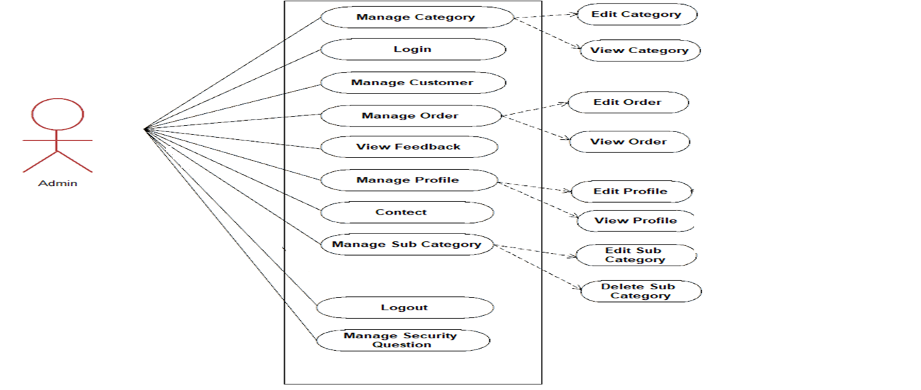
Use case diagram admin:-

Slide 19
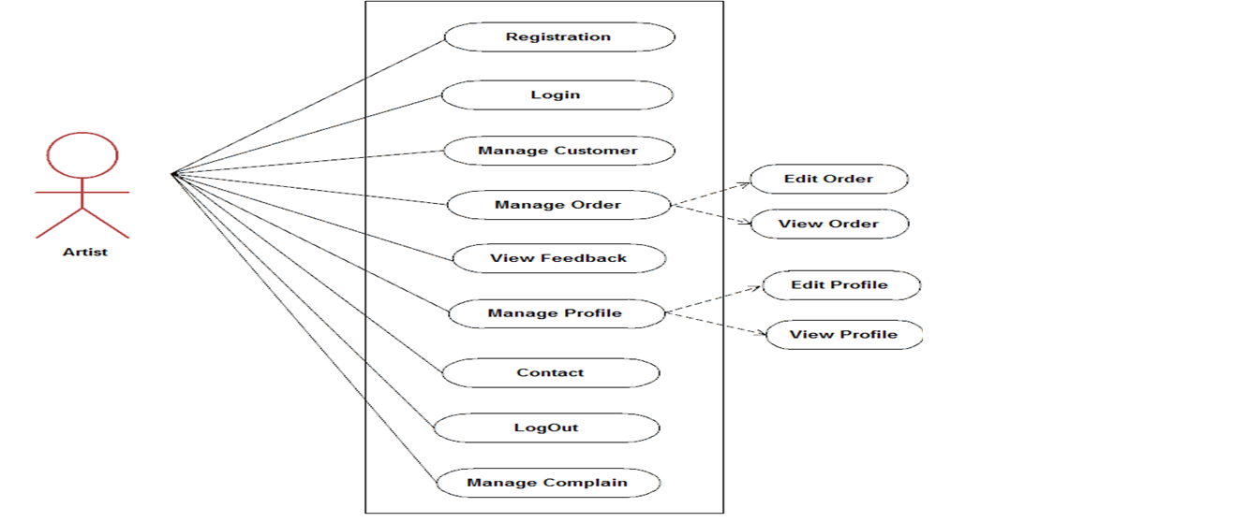
Use case diagram artist:-

Slide 20
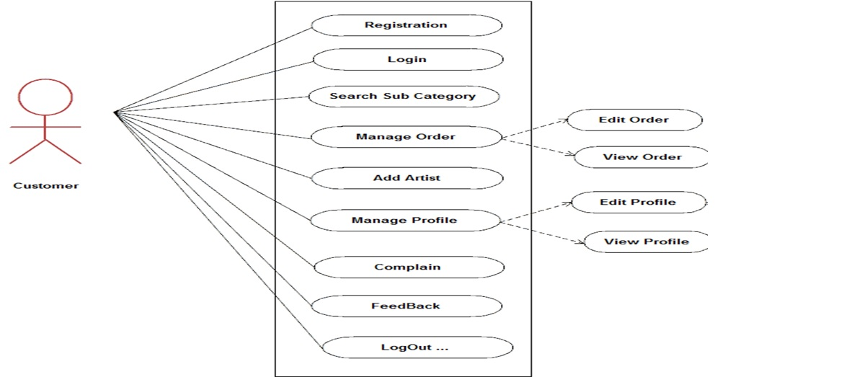
Use case diagram customer:-

Slide 21
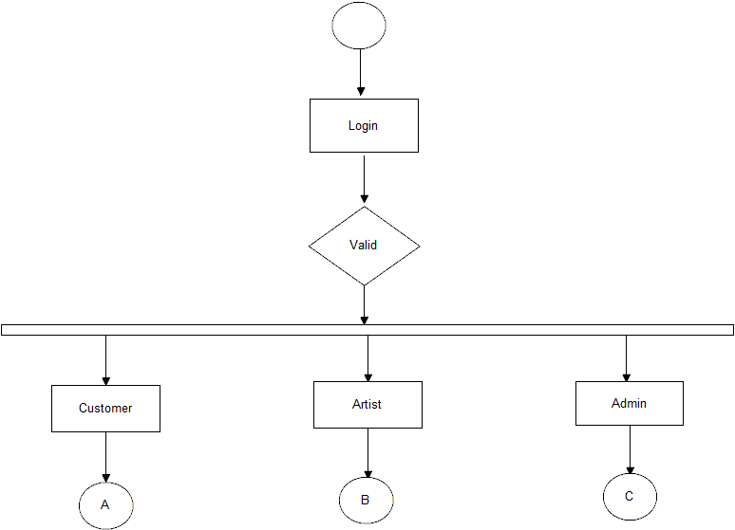
Activity diagram main:-

Slide 22
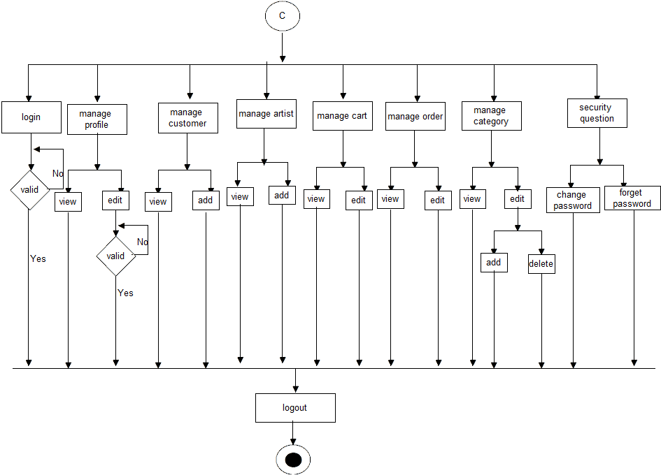
Activity diagram admin:-

Slide 23
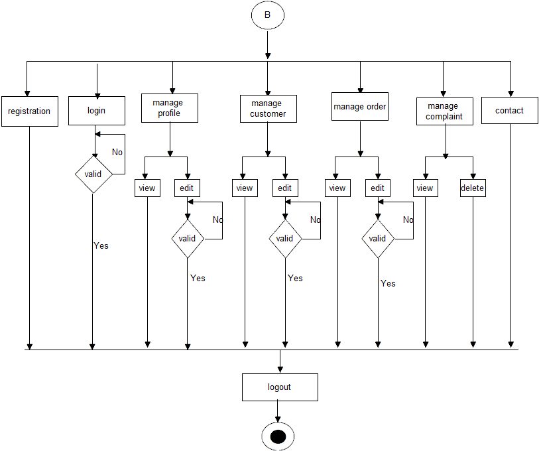
Activity diagram artist:-

Slide 24
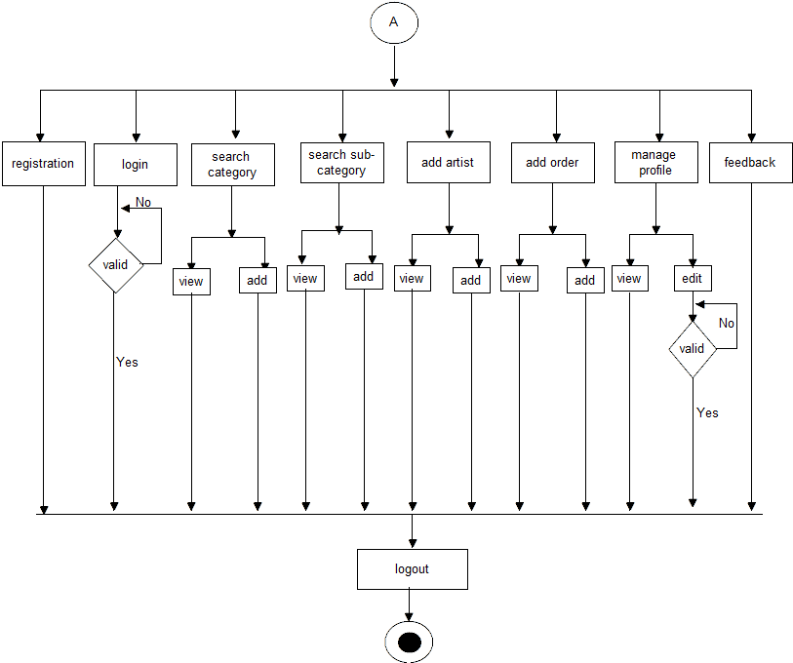
Activity diagram customer:-

Slide 25
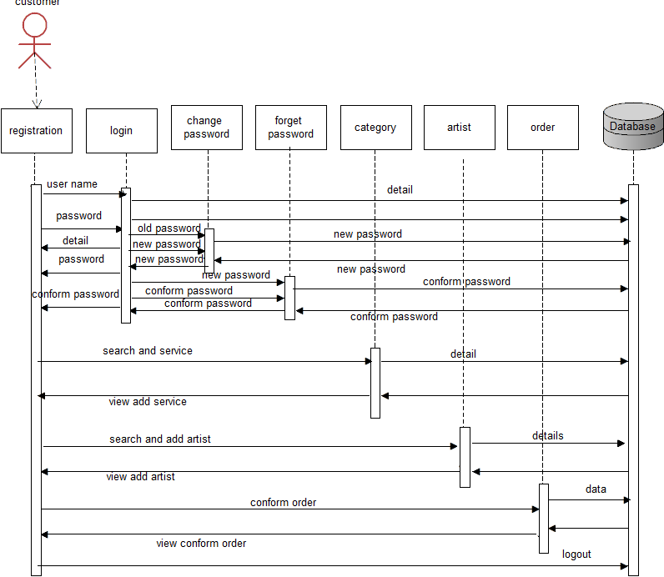
sequence diagram customer:-

Slide 26
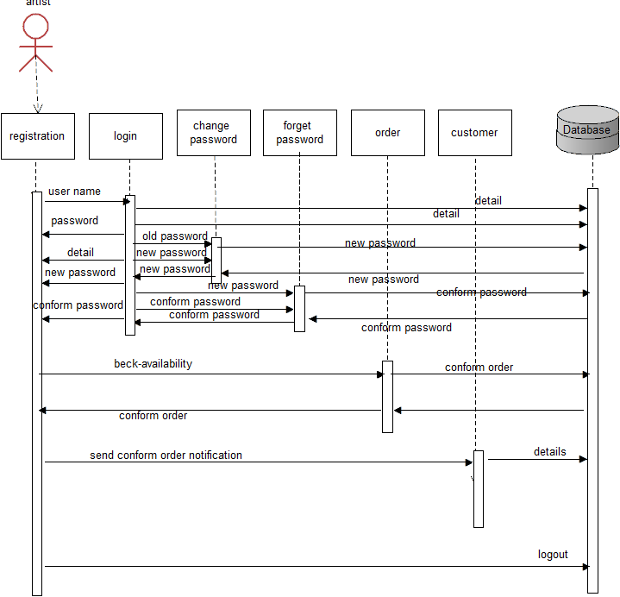
sequence diagram artist:-

Slide 27
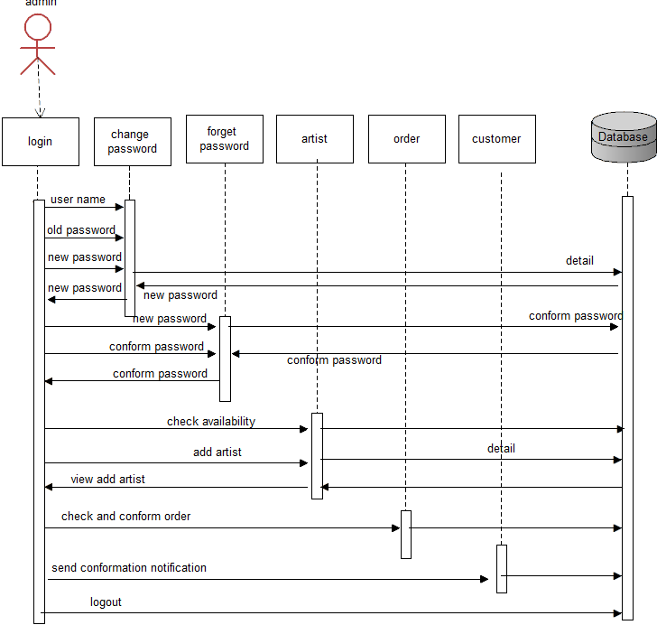
sequence diagram admin:-

Slide 28
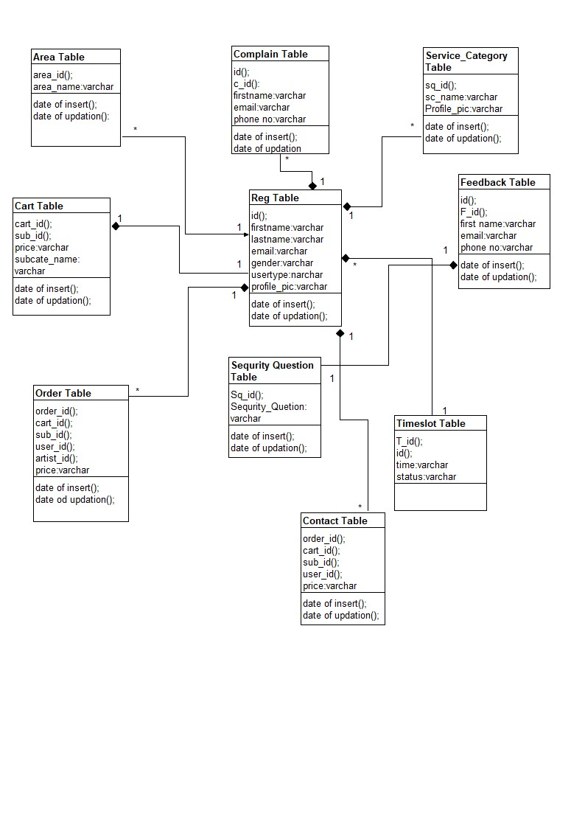
class diagram

Slide 29
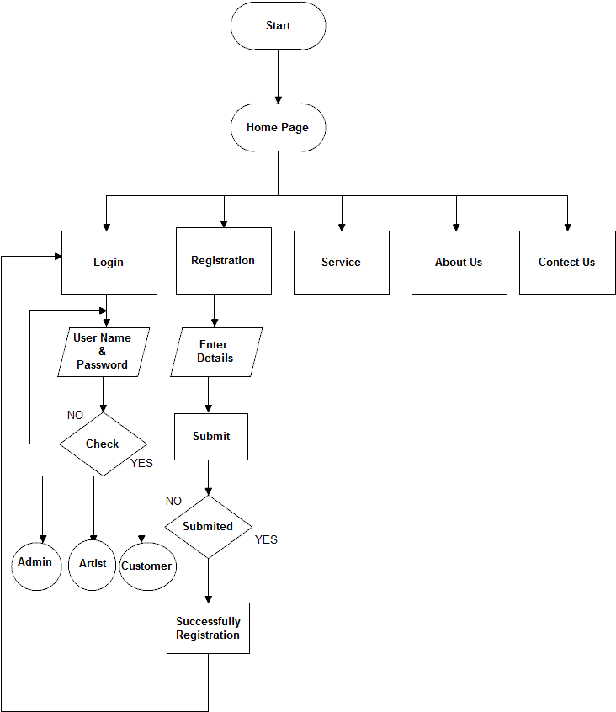
System flow diagram

Slide 30
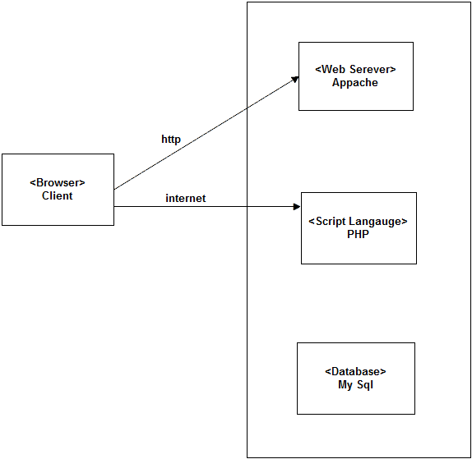
deployment diagram

Slide 31
DATA DICTONARY:-
1. Registration table
2.Area Table
3.Security question Table
4.Service category Table
5.Sub Category table
6.Contact Table
7.Order Table
8.Feedback Table
9.Complaint Table
10.Time Sloat
11.Cart Table

Slide 32
DATA DICTONARY:-
Area Table:-
Sr No. | Field | Data Type | Size | Contains | Descriptions
1 | Area_Id | Integer | 15 | PK | To find area
2 | Area name | Varchar | 100 | Not Null | To find area name
3 | Isactive | Integer | 15 | Not Null | To find area is active or not
4 | Date of insertion | Date | 10 | Not Null | Date of insert
5 | Date of updation | Date | 10 | Not Null | Date of update

Slide 33
DATA DICTONARY:-
Security question table: -
Sr No. | Field | Data Type | size | Contains | Descriptions
1 | Sq_Id | Integer | 15 | PK | To find security question
2 | Security Question | Varchar | 100 | Not Null | For ask security
3 | Isactive | Integer | 15 | Not Null | To find security question is active or not
4 | Date of insertion | Date | 10 | Not Null | Date of insert
5 | Date of updation | Date | 10 | Not Null | Date of update

Slide 34
DATA DICTONARY:-
service category table: -
Sr No. | Field | Data Type | size | Contains | Descriptions
1 | Sq_Id | Integer | 15 | PK | To find service category
2 | Sc_name | Varchar | 100 | Not Null | To find service category name
3 | Profile_pic | Varchar | 100 | Not Null | To find Profile_pic
4 | Isactive | Integer | 10 | Not Null | To find service category is active or not
5 | Date of insertion | Date | 10 | Not Null | Date of insert
6 | Date of updation | Date | 10 | Not Null | Date of update

Slide 35
DATA DICTONARY:-
Cart table: -
Sr No. | Field | Data Type | Size | Contains | Descriptions
1 | Cart_Id | Integer | 15 | PK | To find cart
2 | Sub_Id | Integer | 15 | FK | To find service
3 | Price | Varchar | 100 | Not Null | To find service price
4 | Subcate_name | varchar | 50 | Not Null | To find subcate_name
5 | Isactive | Integer | 10 | Not Null | To find cart is active or not
6 | Date of insertion | Date | 10 | Not Null | Date of insert
7 | Date of updation | Date | 10 | Not Null | Date of update

Slide 36
DATA DICTONARY:-
feedback table: -
Sr No. | Field | Data Type | Size | Contains | Descriptions
1 | Id | Integer | 11 | FK | To find feedback
2 | F_Id | Integer | 15 | PK | To find feedback
3 | First name | Varchar | 20 | Not Null | To give user name
4 | Email | Varchar | 50 | Not Null | To verify user
5 | Phone No. | Varchar | 10 | Not Null | To verify no
6 | Message | Varchar | 100 | Not Null | To give feedback
7 | Isactive | Integer | 10 | Not Null | To find feedback is active or not
8 | Date of insertion | Date | 10 | Not Null | Date of insert
9 | Date of updation | Date | 10 | Not Null | Date of update

Slide 37
DATA DICTONARY:-
Complain table: -
Sr No. | Field | Data Type | Size | Contains | Descriptions
1 | Id | Integer | 11 | FK | To find complaint
2 | C_id | Integer | 15 | PK
2 | First name | Varchar | 100 | Not Null | To find user name
3 | Email | Varchar | 100 | Not Null | To verify user
4 | Phone No. | Varchar | 10 | Not Null | To verify no
5 | Message | Varchar | 100 | Not Null | To send complaint message
6 | Isactive | Integer | 15 | Not Null | To find complaint is active or not
7 | Date of insertion | Date | 10 | Not Null | Date of insert
8 | Date of updation | Date | 10 | Not Null | Date of update

Slide 38
DATA DICTONARY:-
Order table: -
Sr No. | Field | Data Type | size | Contains | Descriptions
1 | Order_Id | Integer | 11 | PK | To find order
2 | Cart_id | Integer | 11 | FK | To find cart_id
3 | Sub_id | Integer | 11 | FK | To find sub_ category id
4 | User_id | Integer | 11 | Not Null | To find user_id
5 | Price | Varchar | 100 | Not Null | To show price
6 | Artist_id | Integer | 11 | Not Null | To find artist_id
7 | T_id | Integer | 11 | Not Null | To find t_id
8 | Isactive | Integer | 10 | Not Null | To find service is active or not
9 | Date of insertion | Date | 10 | Not Null | Date of insert
10 | Orderuserid | Integer | 11 | Not Null | To find order user id

Slide 39
DATA DICTONARY:-
Reg table: -
Sr No. | Field | Data Type | Size | Contains | Descriptions
1 | Id | Integer | 11 | PK | To find user
2 | First name | Varchar | 20 | Not Null | To find user name
3 | Last name | Varchar | 20 | Not Null | To find user name
4 | Email | Varchar | 50 | Not Null | To verify the user
5 | Gender | Varchar | 10 | Not Null | Choose gender
6 | Password | Varchar | 20 | Not Null | To verify the user
7 | User type | Varchar | 20 | Not Null | Admin,artist customer
8 | Sq_que1 | varchar | 100 | Not Null | To find city
9 | Profile pic | Varchar | 100 | Not Null | For profile pic
10 | Sq_ans1 | Integer | 100 | Not Null | To find area

Slide 40
DATA DICTONARY:-
Reg table: -
11 | Address | Varchar | 100 | Not Null | To store address
12 | Sq_que2 | Varchar | 100 | Not Null | To find security question
13 | Sq_ans2 | Varchar | 100 | Not Null | To give answer
14 | Mobile no. | Varchar | 10 | Not Null | To verify no
15 | Sq_que3 | Varchar | 100 | Not Null | To find security question
16 | Sq_ans3 | varchar | 100 | Not Null | To find answer
17 | Skill | varchar | 100 | Not Null | To show skill
18 | Discription | varchar | 100 | Not Null | To show description
19 | is active | Integer | 10 | Not Null | To find user is active or not
20 | Date of insertion | Date | 10 | Not Null | Date of insert
21 | Date of updation | Date | 10 | Not Null | Date of update

Slide 41
DATA DICTONARY:-
Timeslot table: -
Sr No. | Field | Data Type | size | Contains | Descriptions
1 | T_Id | Integer | 11 | PK | To find time id
2 | Id | Integer | 11 | FK | To find cart_id
3 | Time | Varchar | 100 | Not Null | To show time
4 | Status | Varchar | 30 | Not Null | To show Status
5 | Isactive | Integer | 11 | Not Null | To show Subject

Slide 42
DATA DICTONARY:-
Contact table: -
Sr No. | Field | Data Type | size | Contains | Descriptions
1 | Order_Id | Integer | 11 | PK | To find order
2 | Cart_id | Integer | 11 | FK | To find cart_id
3 | Sub_id | Integer | 11 | FK | To find sub_ category id
4 | User_id | Integer | 11 | Not Null | To find user_id
5 | Price | Varchar | 100 | Not Null | To show price
6 | Artist_id | Integer | 11 | Not Null | To find artist_id
7 | T_id | Integer | 11 | Not Null | To find t_id
8 | Isactive | Integer | 10 | Not Null | To find service is active or not
9 | Date of insertion | Date | 10 | Not Null | Date of insert
10 | Orderuserid | Integer | 11 | Not Null | To find order user id

Slide 43
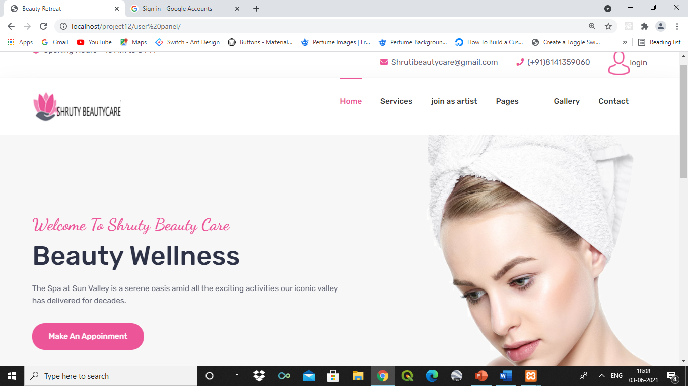
USER INTERFACE:-
Home:-

Slide 44
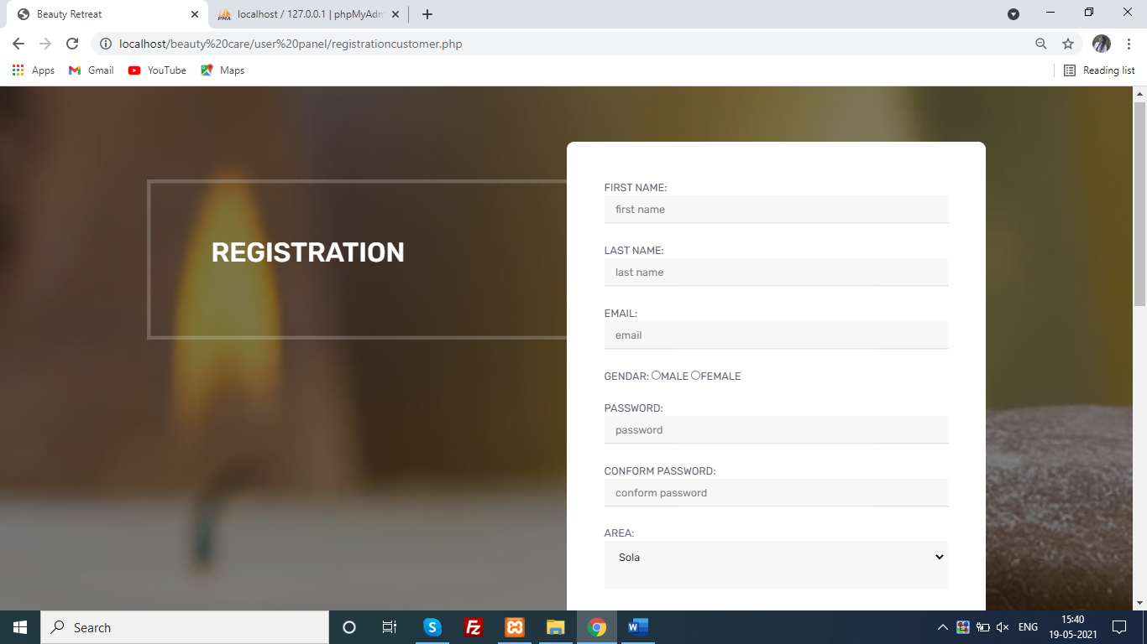
USER INTERFACE:-
Registration:-

Slide 45
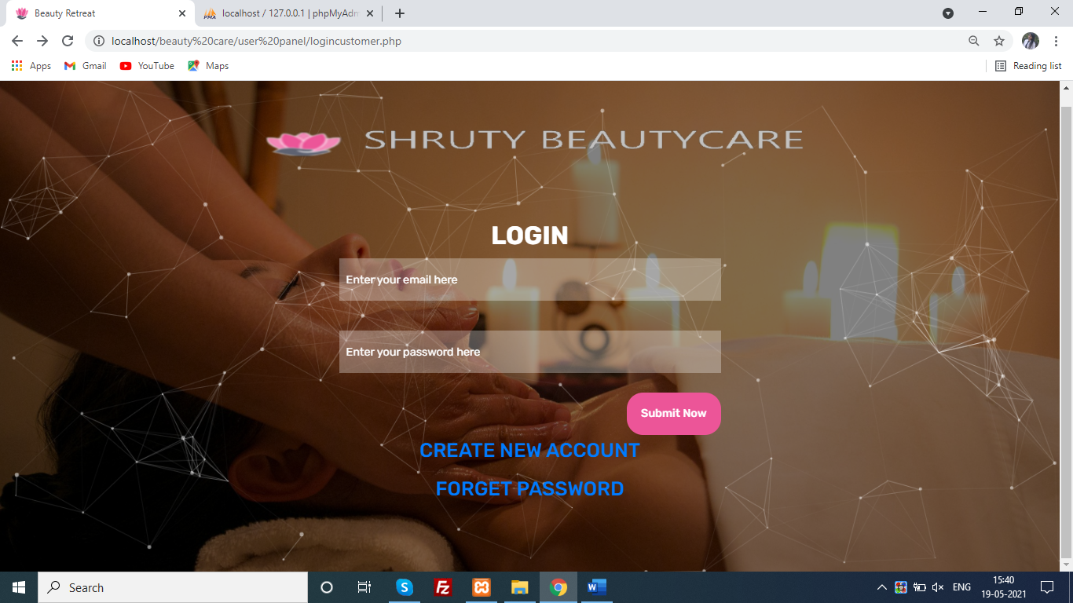
USER INTERFACE:-
Login:-

Slide 46
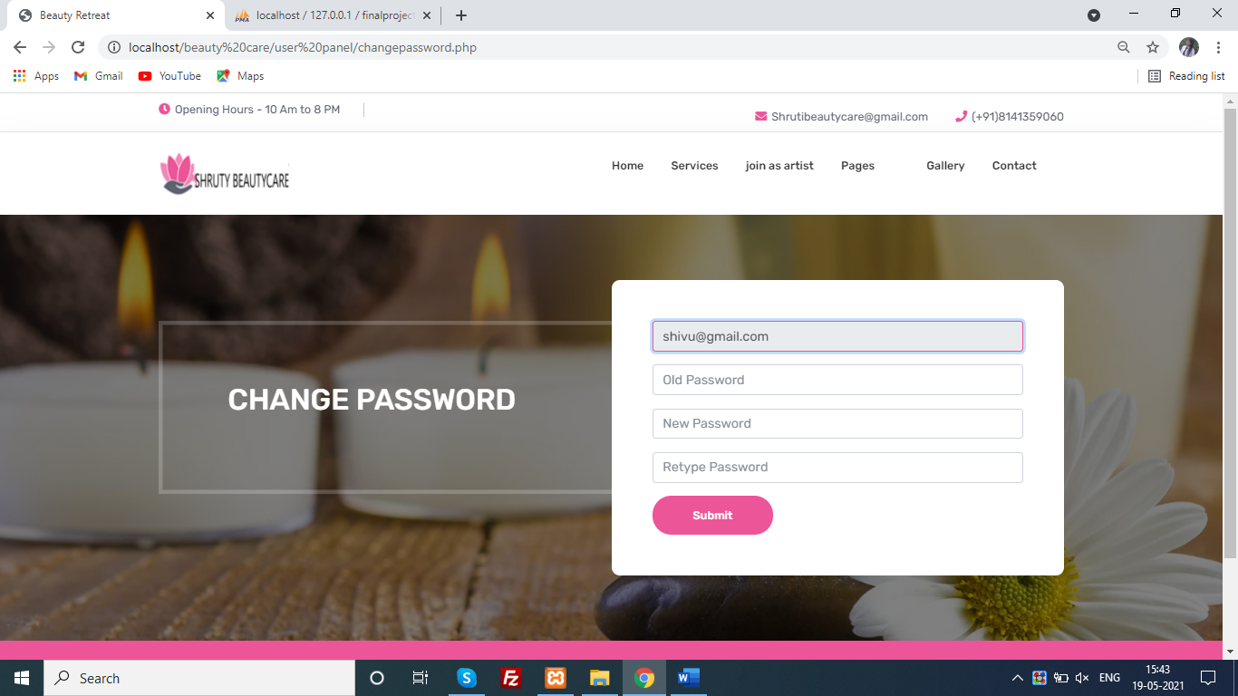
USER INTERFACE:-
Change Password:-

Slide 47
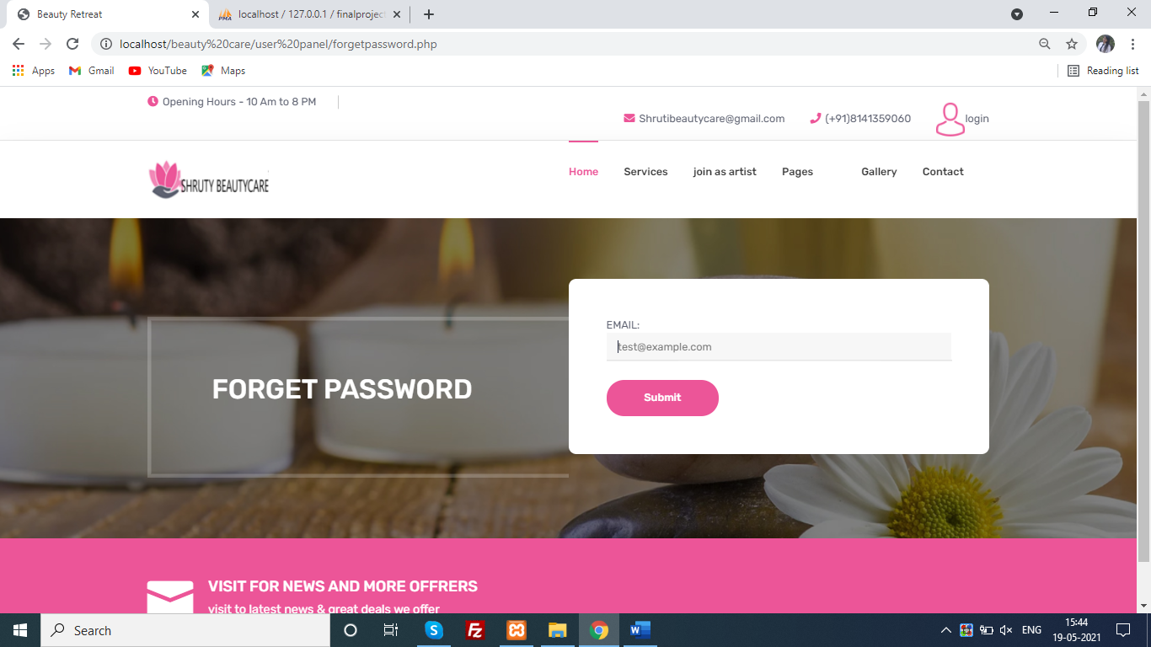
USER INTERFACE:-
Forget Password:-

Slide 48
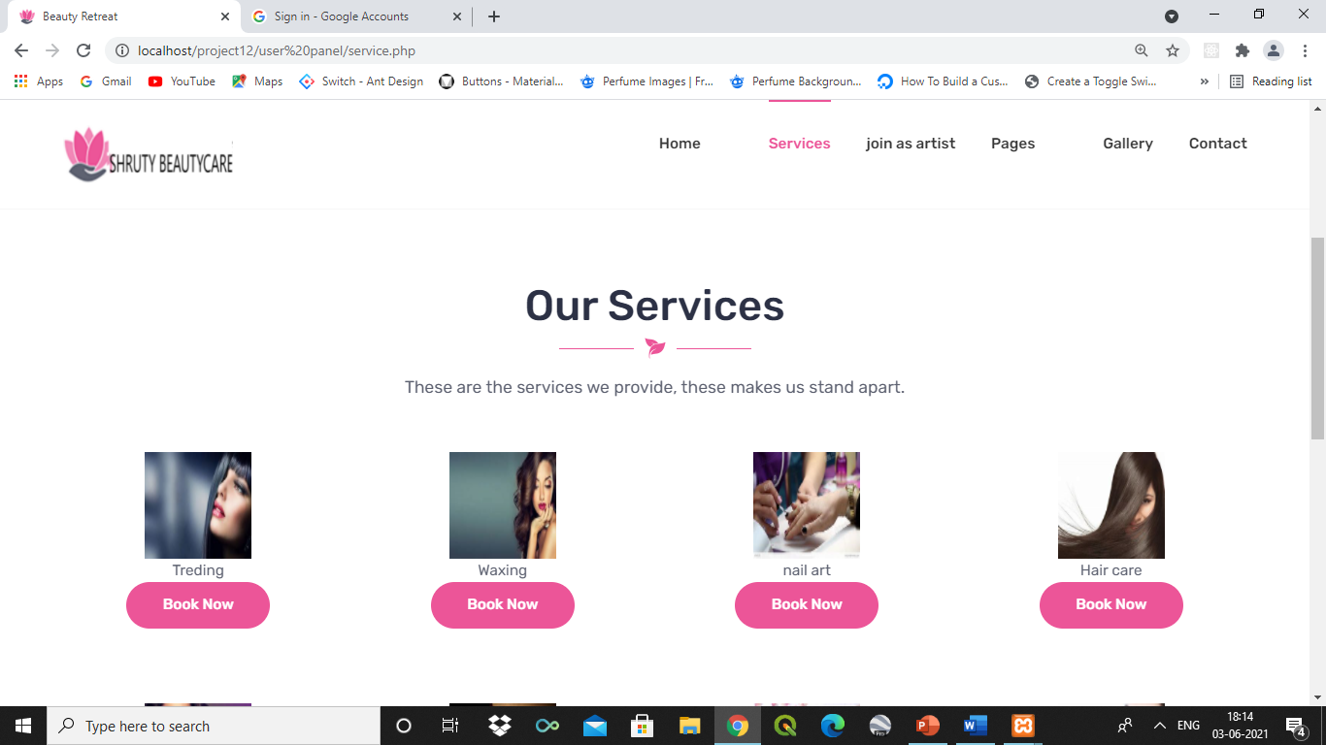
USER INTERFACE:-
services:-

Slide 49
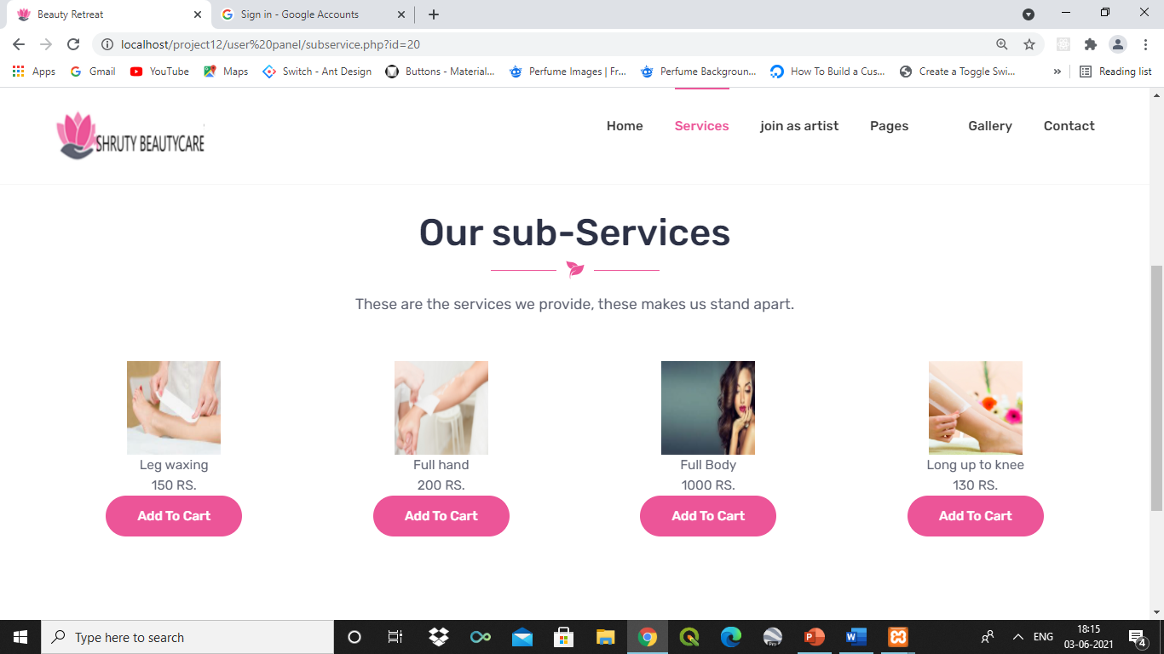
USER INTERFACE:-
Sub services:-

Slide 50
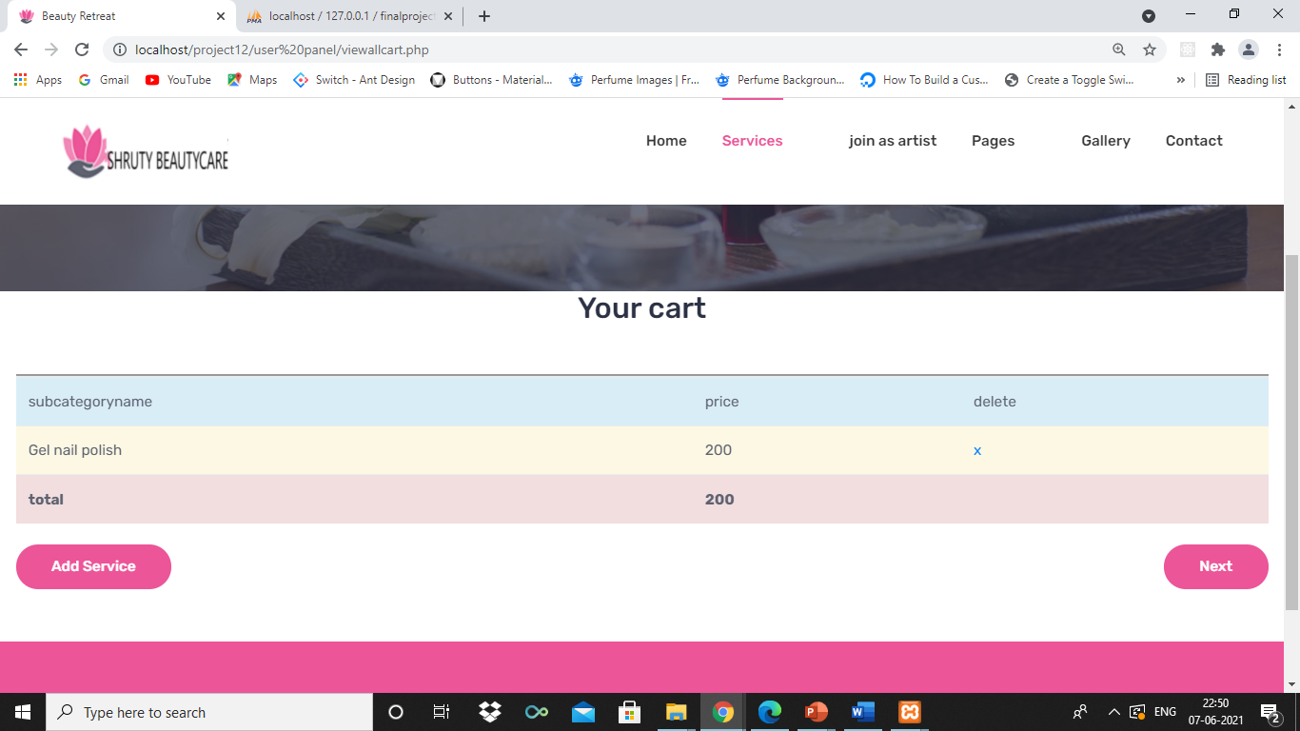
USER INTERFACE:-
view cart:-

Slide 51
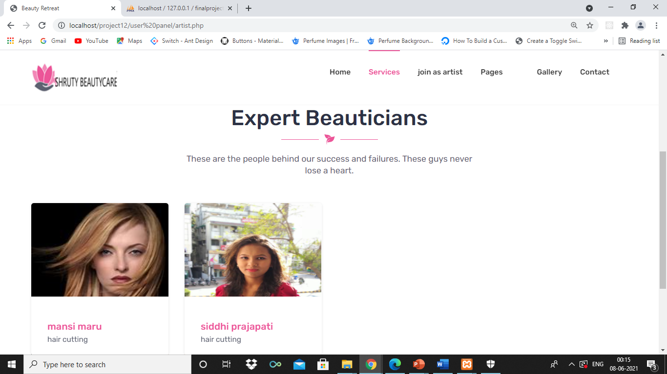
USER INTERFACE:-
Artist:-

Slide 52
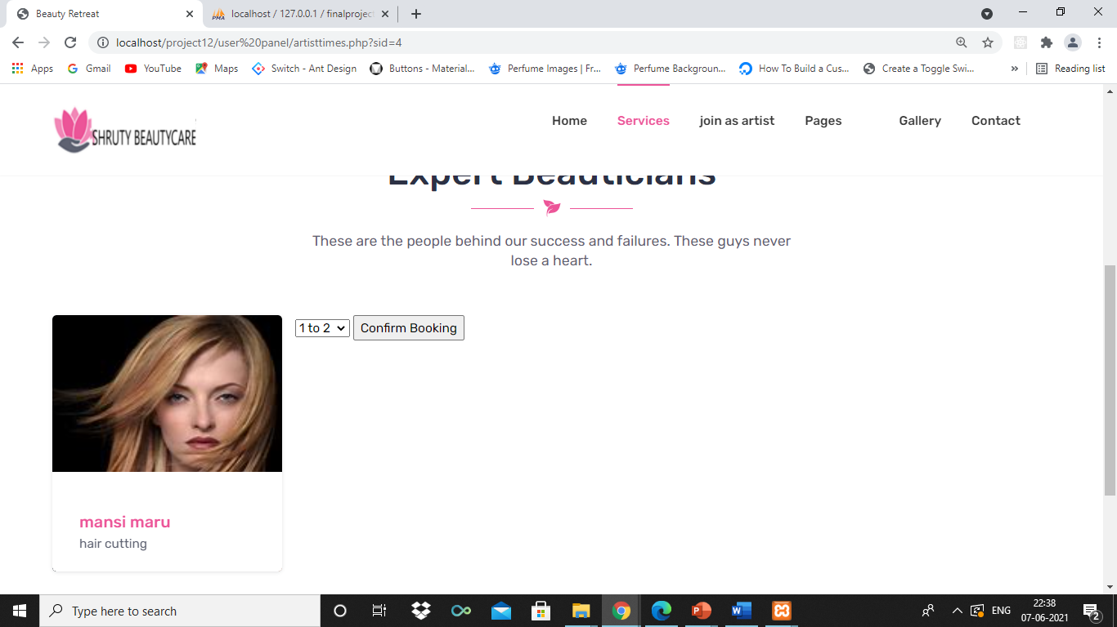
USER INTERFACE:-
Artist Slot:-

Slide 53
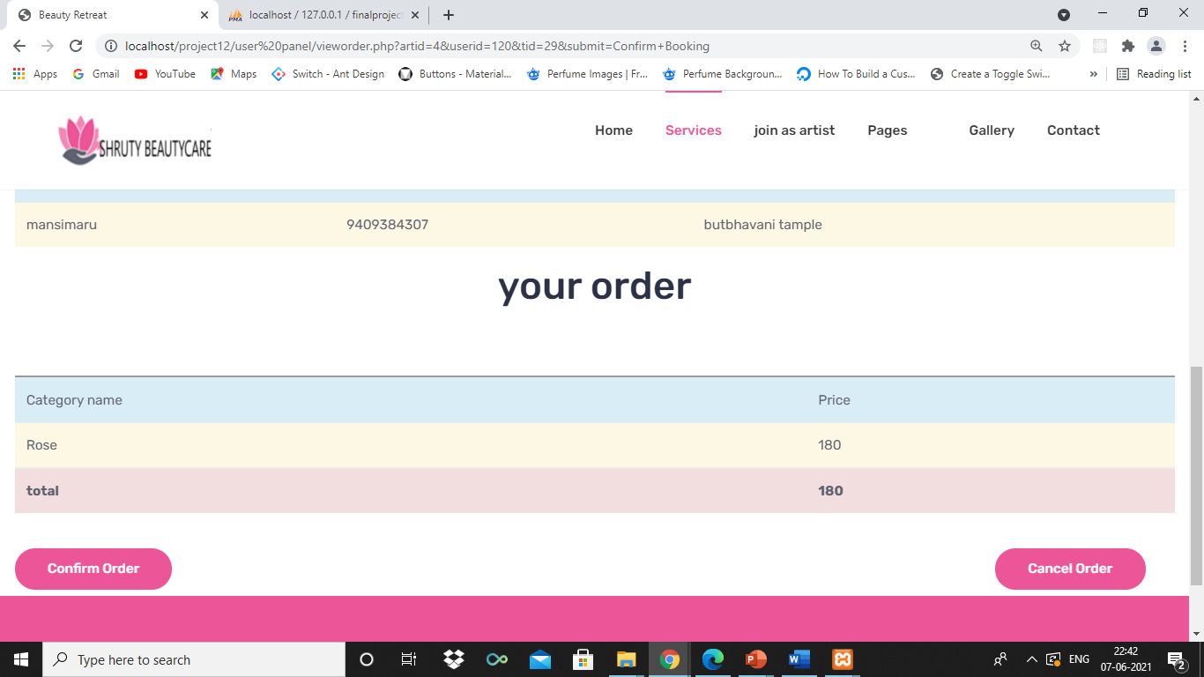
USER INTERFACE:-
Order Information:-

Slide 54
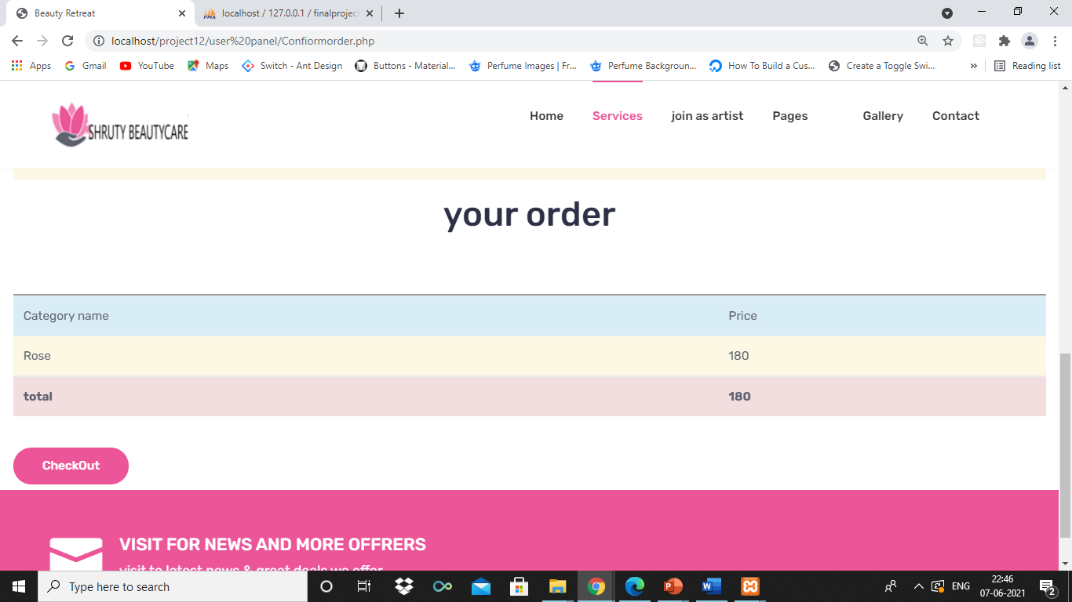
USER INTERFACE:-
Confirm Order :-

Slide 55
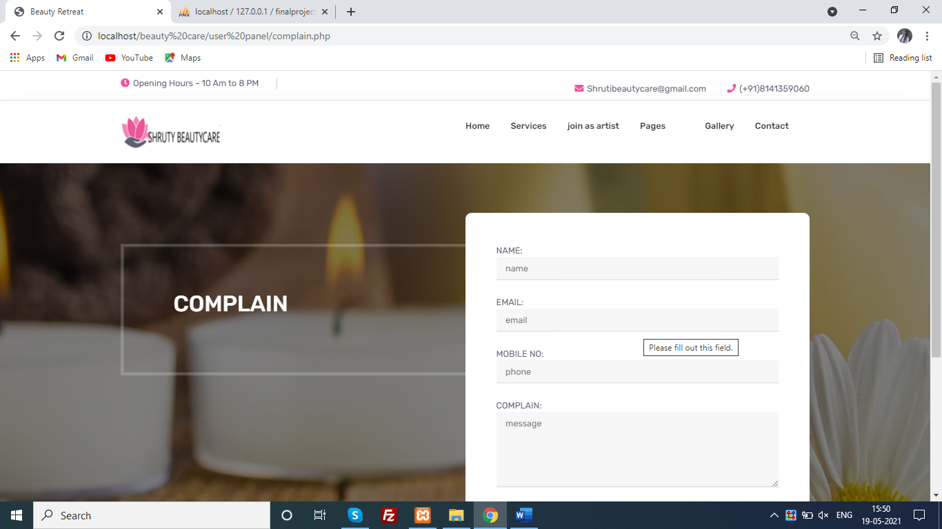
USER INTERFACE:-
Complain:-

Slide 56
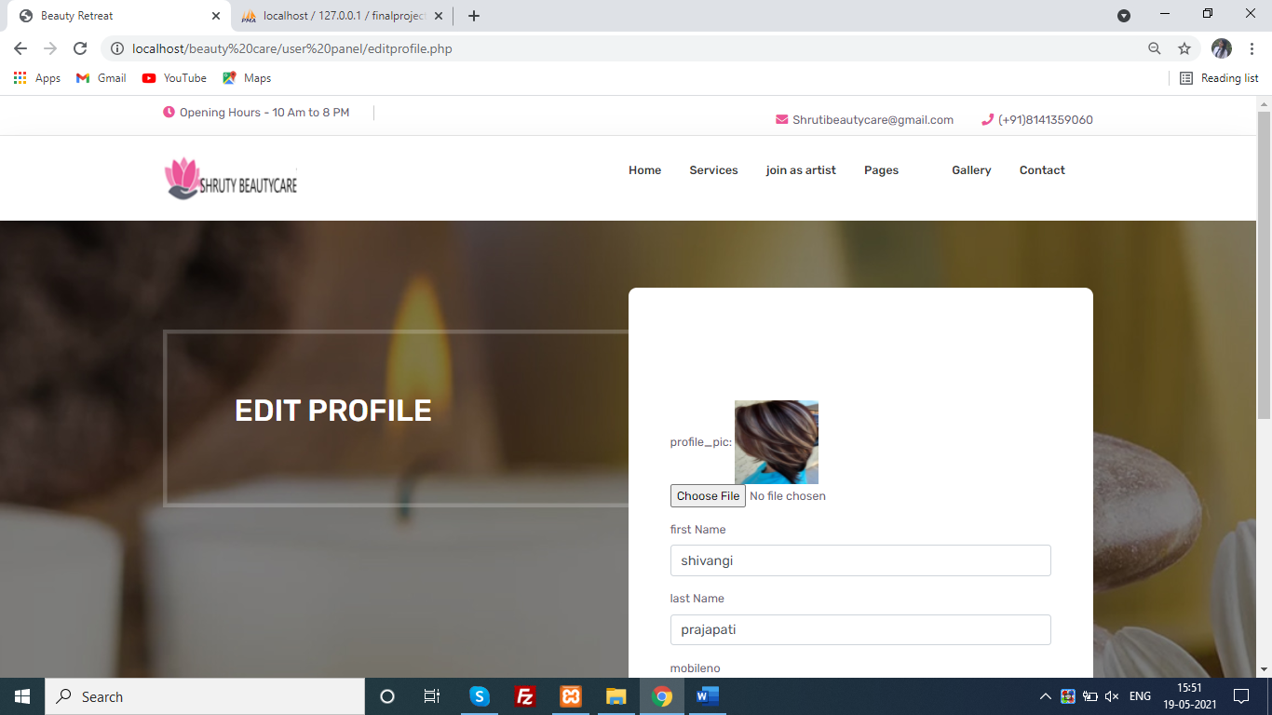
USER INTERFACE:-
Edit Profile:-

Slide 57
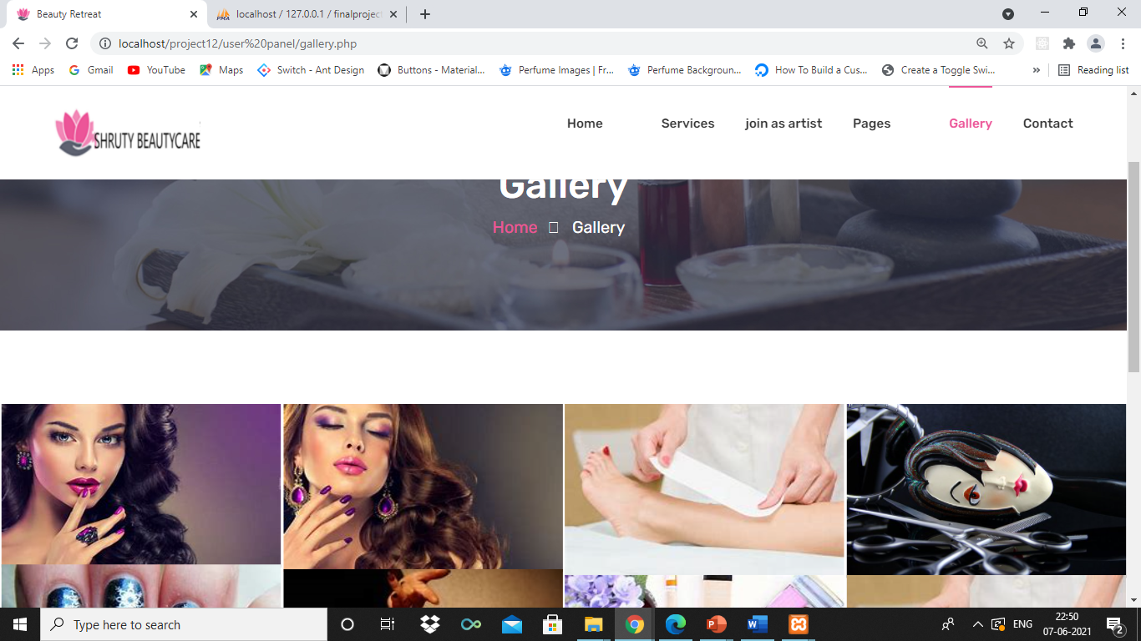
USER INTERFACE:-
Gallery:-

Slide 58
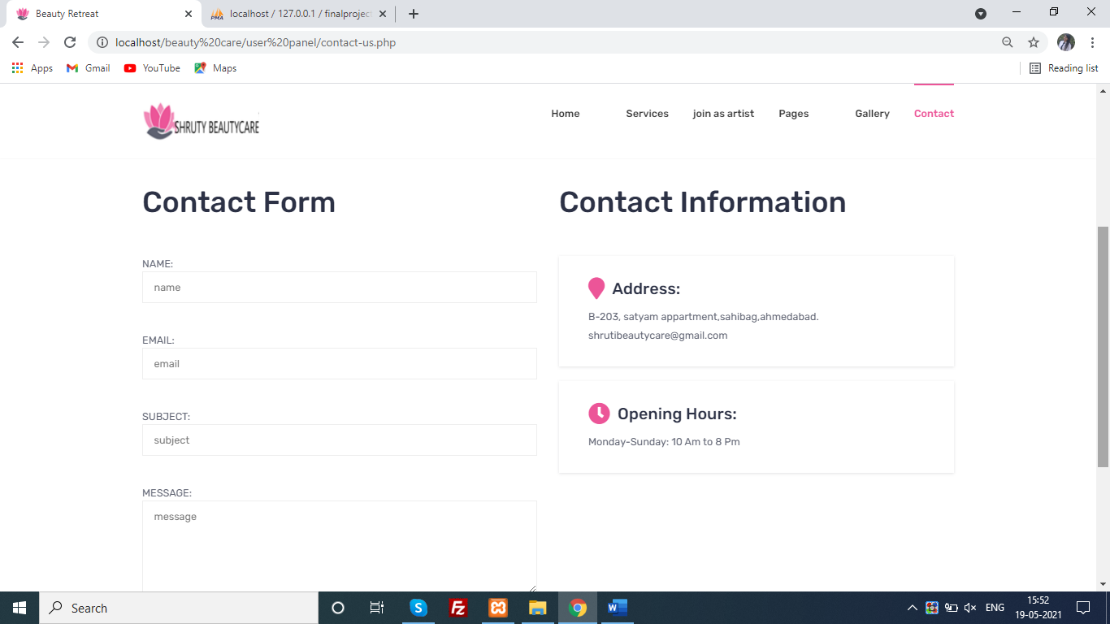
USER INTERFACE:-
Contact us:-

Slide 59

USER INTERFACE:-
Feedback:-

Slide 60
USER INTERFACE:-
Change password:-

Slide 61
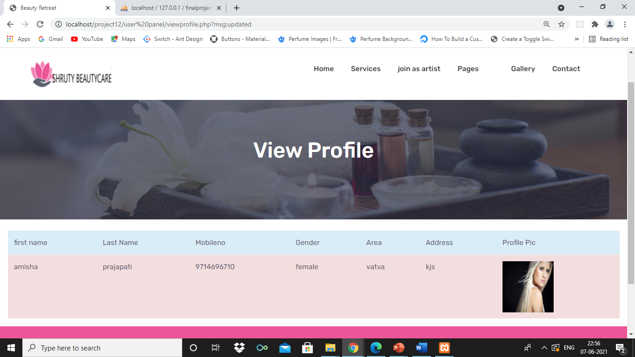
USER INTERFACE:-
View profile:-

Slide 62
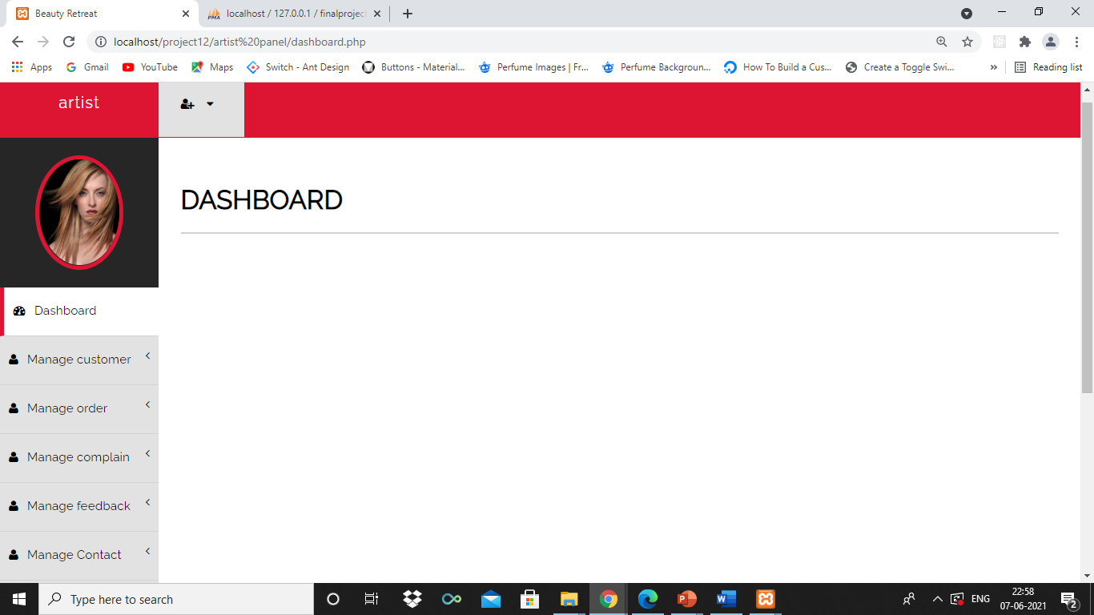
ARTIST INTERFACE:-
Home:-

Slide 63
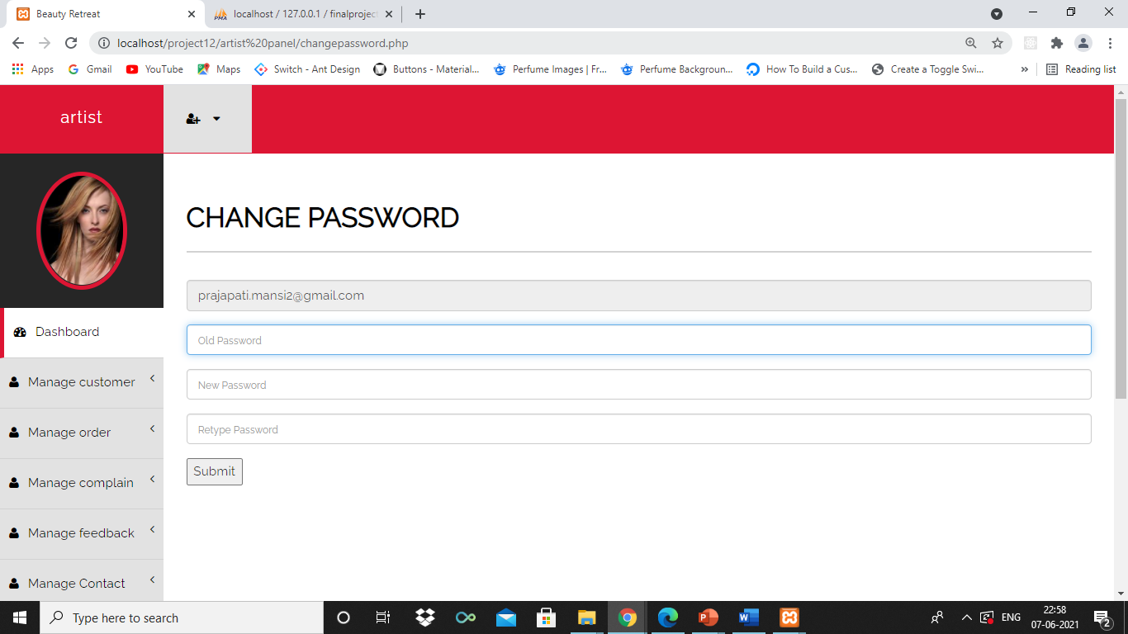
ARTIST INTERFACE:-
Change Password:-

Slide 64
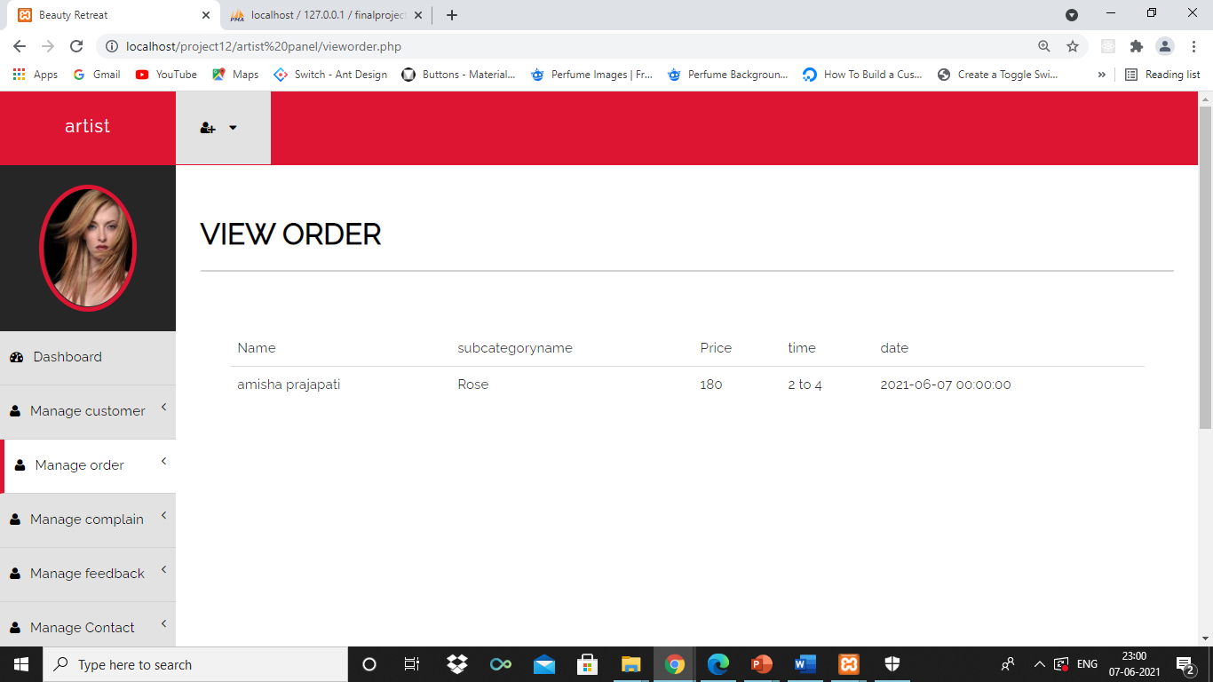
ARTIST INTERFACE:-
View order:-

Slide 65
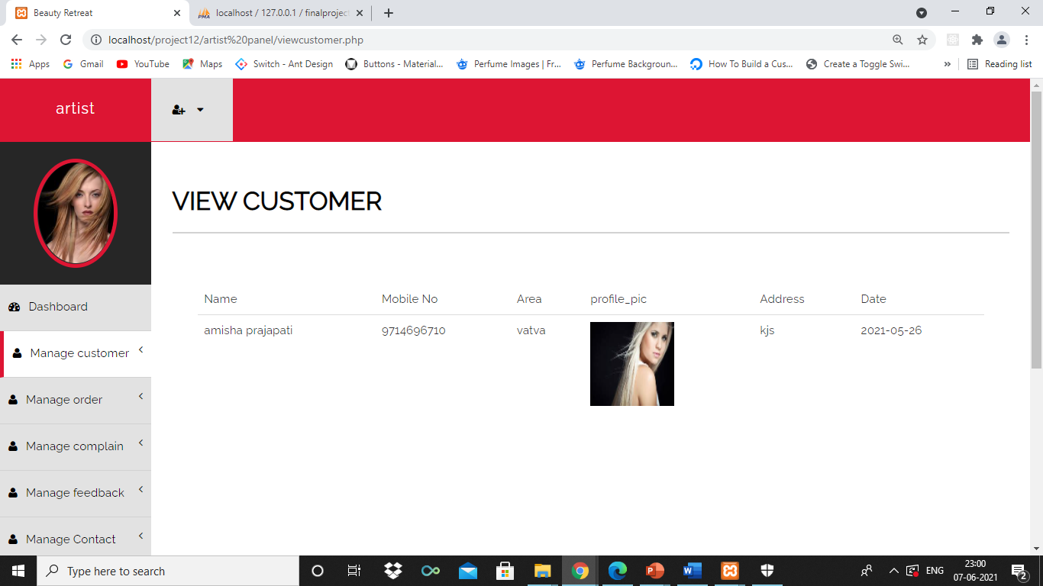
ARTIST INTERFACE:-
View customer:-

Slide 66
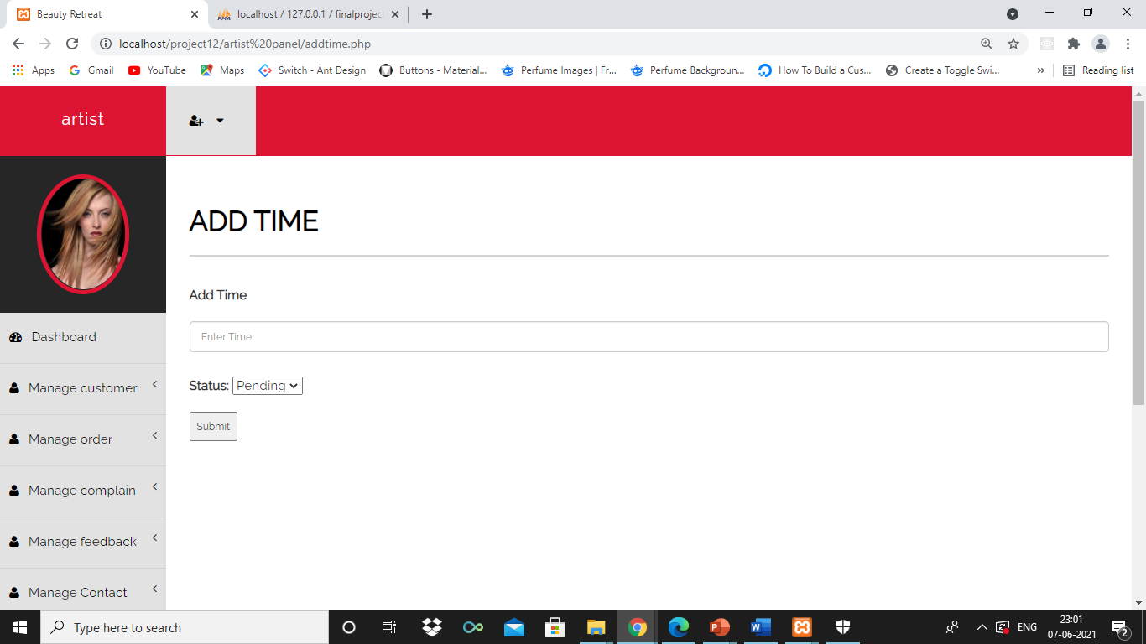
ARTIST INTERFACE:-
Add time:-

Slide 67
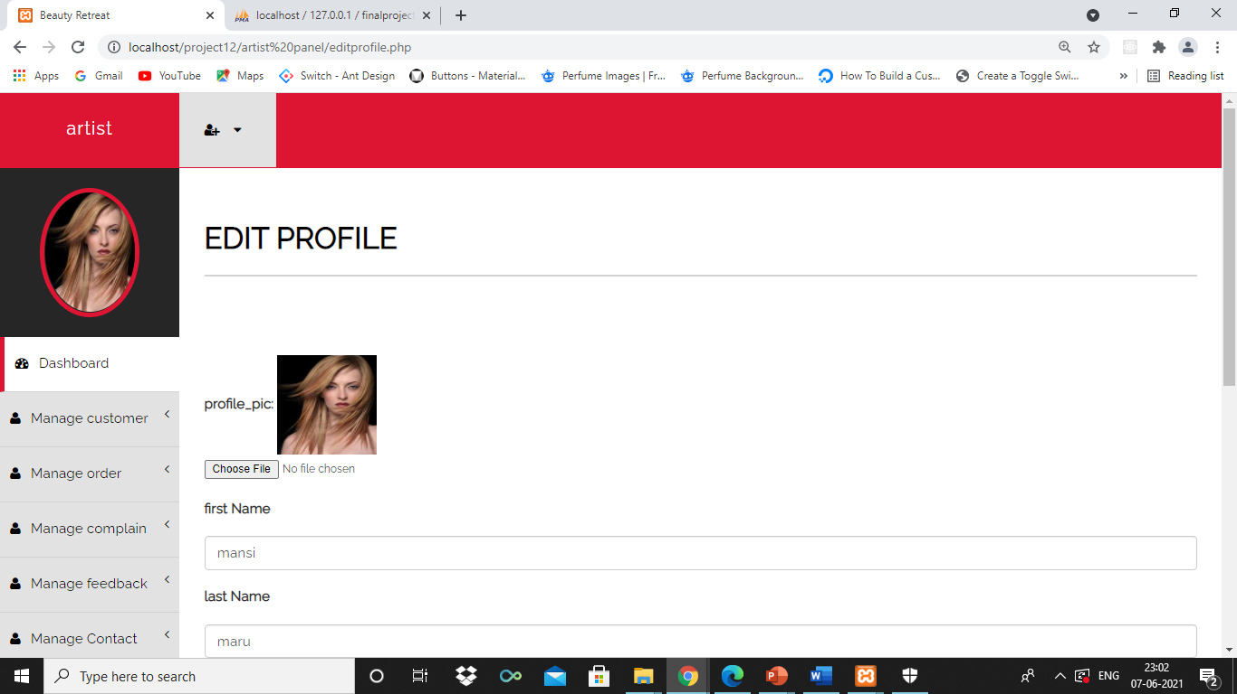
ARTIST INTERFACE:-
Edit Profile:-

Slide 68

ARTIST INTERFACE:-
Edit Time:-

Slide 69
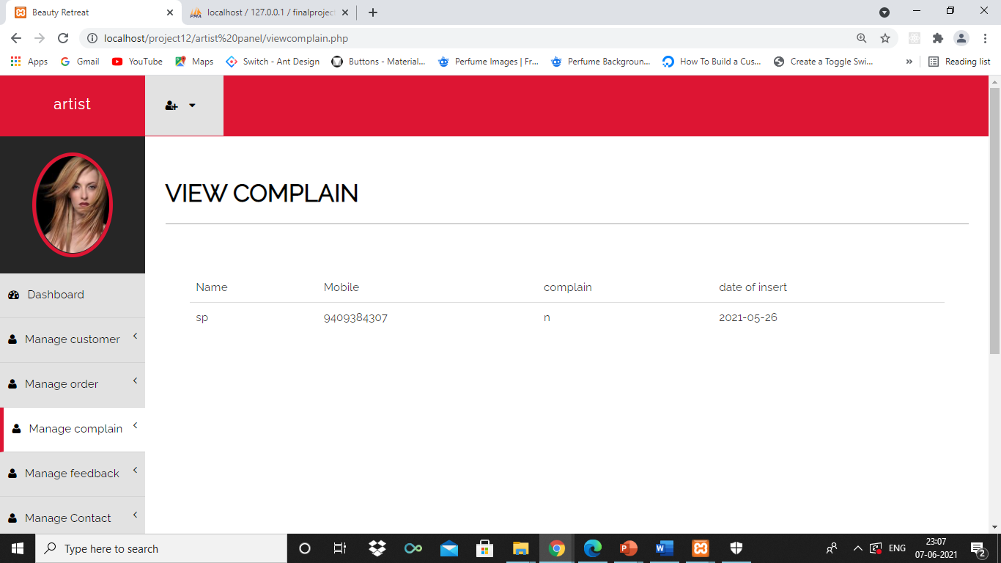
ARTIST INTERFACE:-
View Complain:-

Slide 70
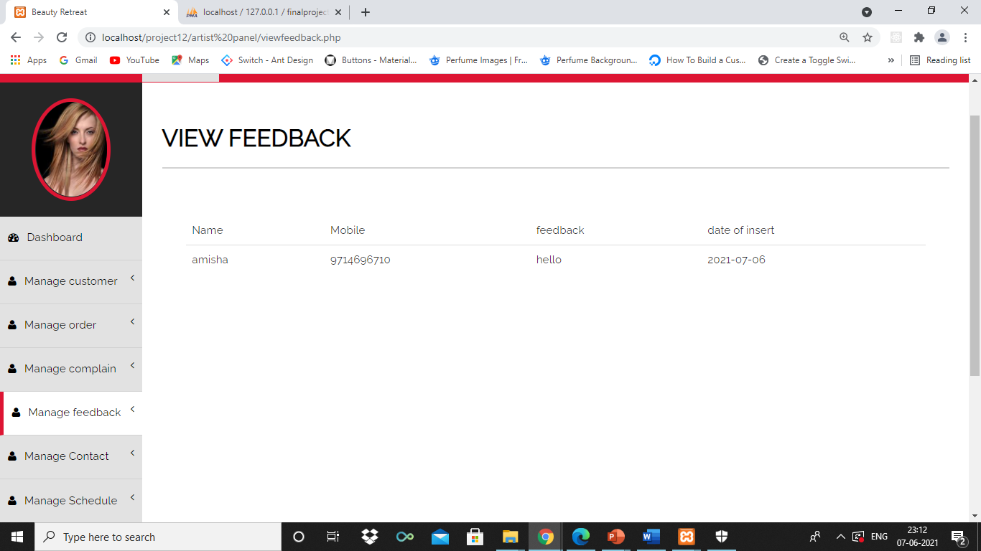
ARTIST INTERFACE:-
View feedback:-

Slide 71
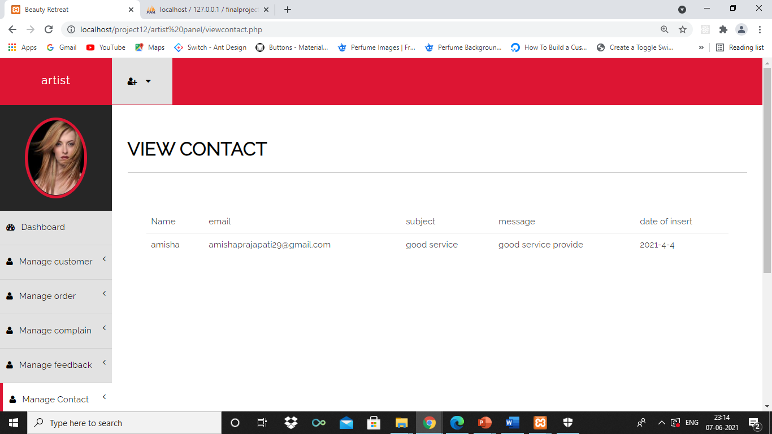
ARTIST INTERFACE:-
View Contact:-

Slide 72
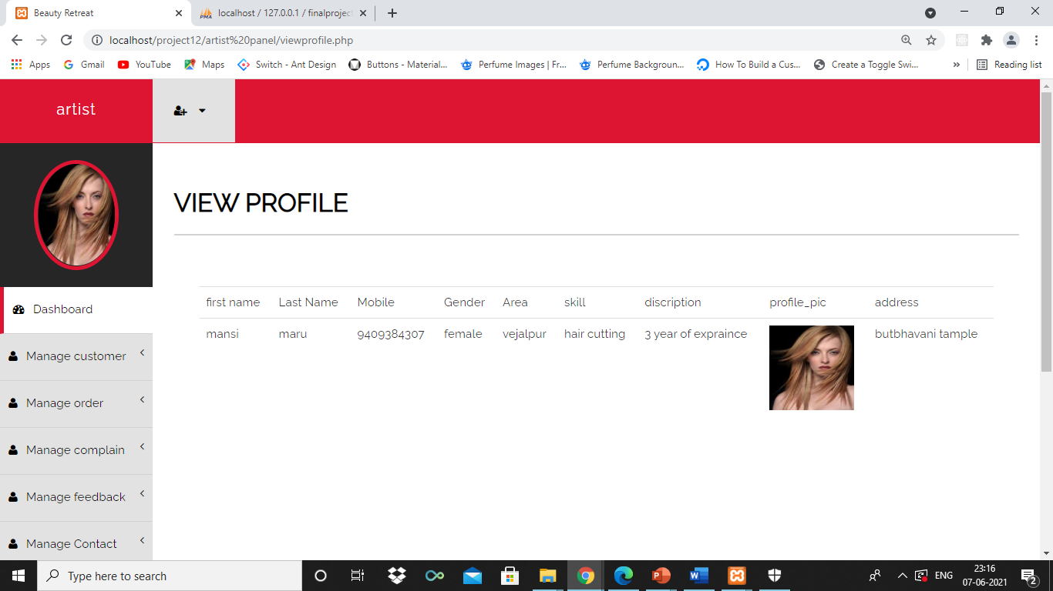
ARTIST INTERFACE:-
View Profile:-

Slide 73

ARTIST INTERFACE:-
View time:-

Slide 74
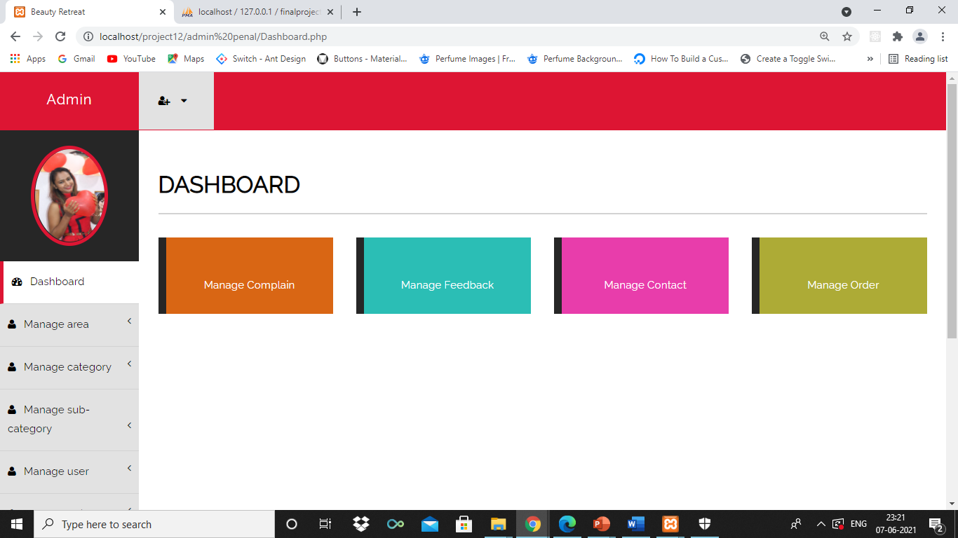
ADMIN INTERFACE:-
Home:-

Slide 75
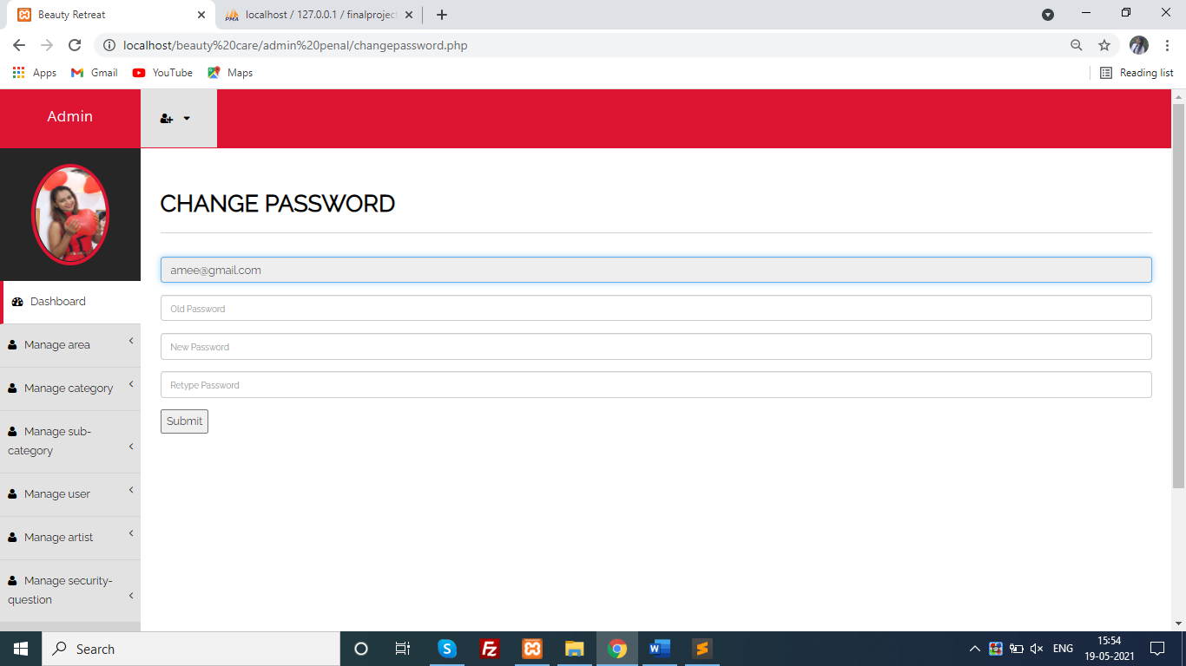
ADMIN INTERFACE:-
Change Password:-

Slide 76
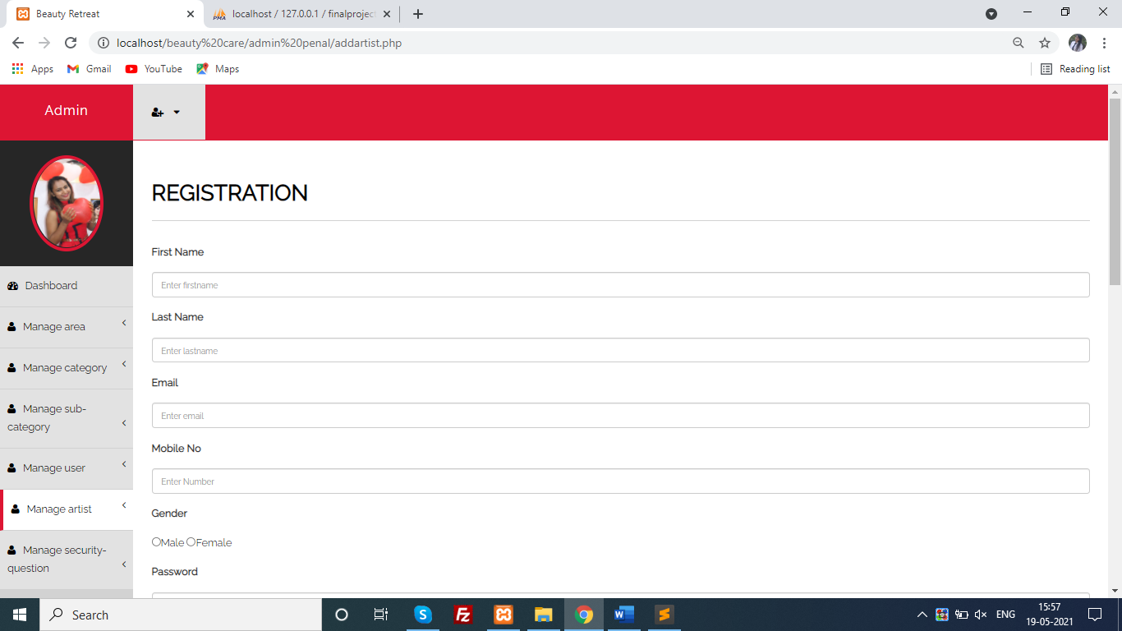
ADMIN INTERFACE:-
Add Artist:-

Slide 77
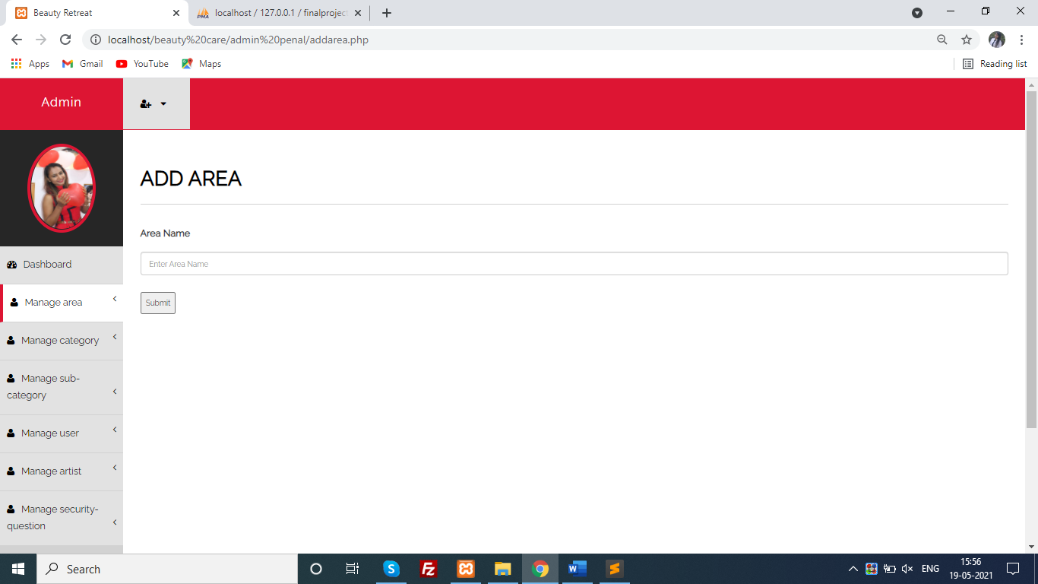
ADMIN INTERFACE:-
Add Area:-

Slide 78
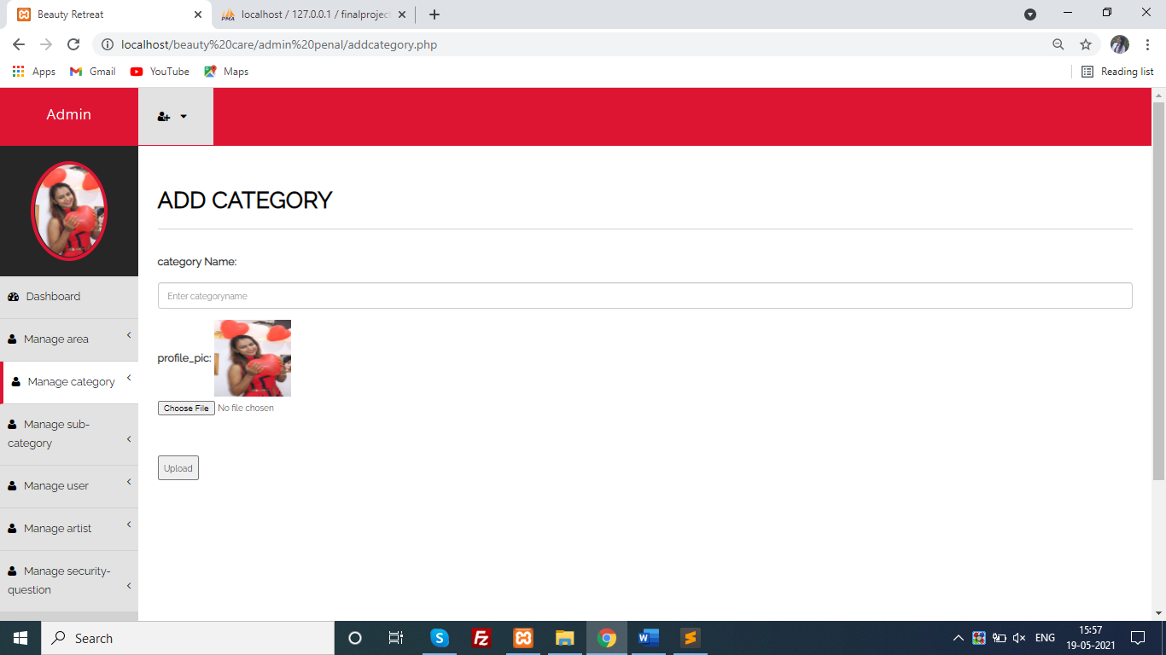
ADMIN INTERFACE:-
Add Category:-

Slide 79
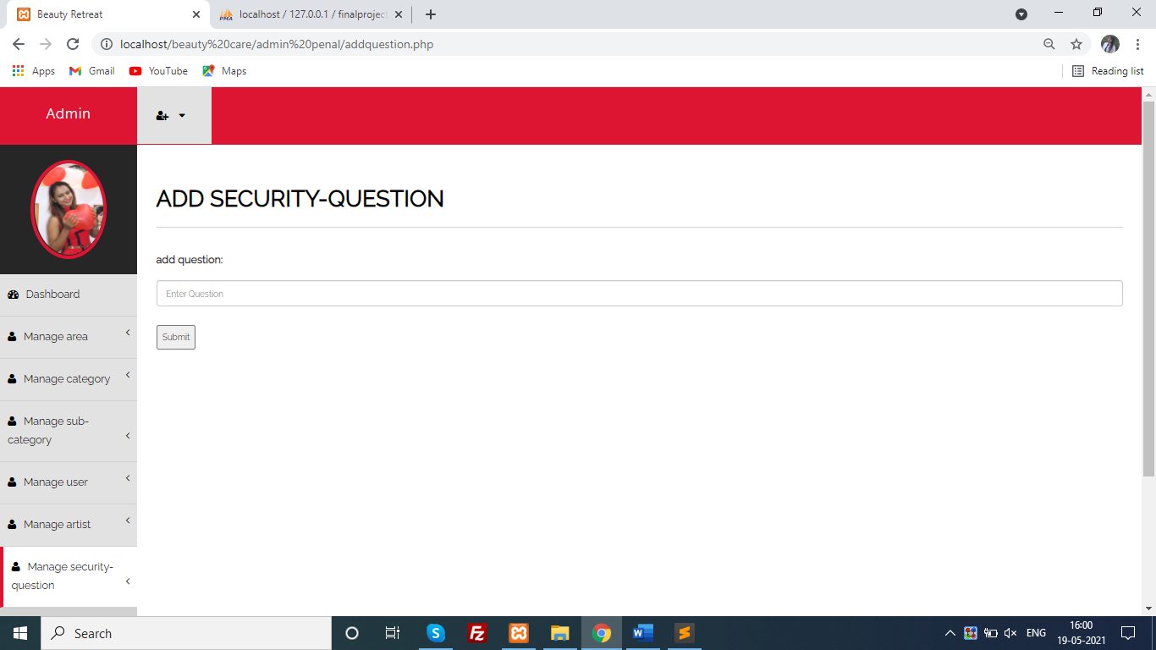
ADMIN INTERFACE:-
Add security Question:-

Slide 80
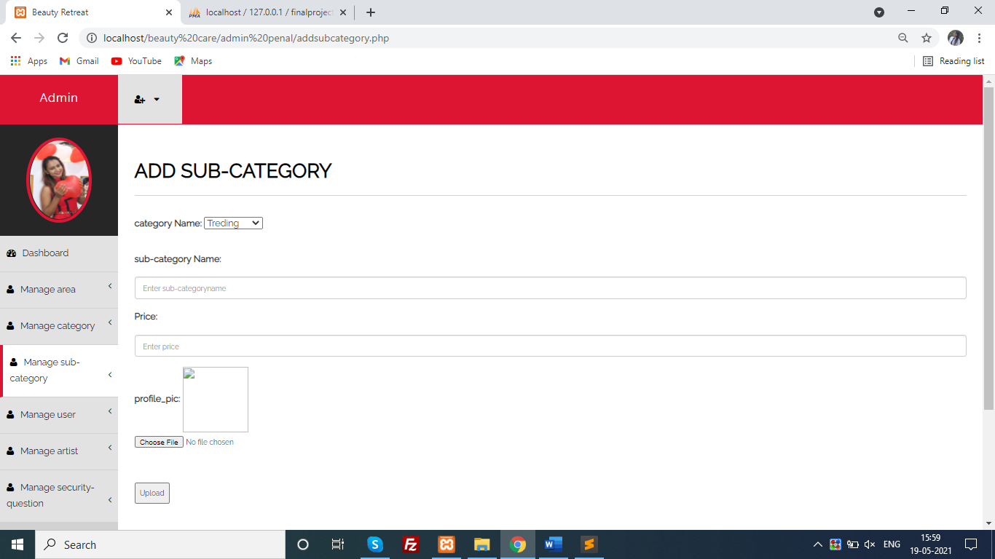
ADMIN INTERFACE:-
Add Sub Category:-

Slide 81

ADMIN INTERFACE:-
Add User:-

Slide 82
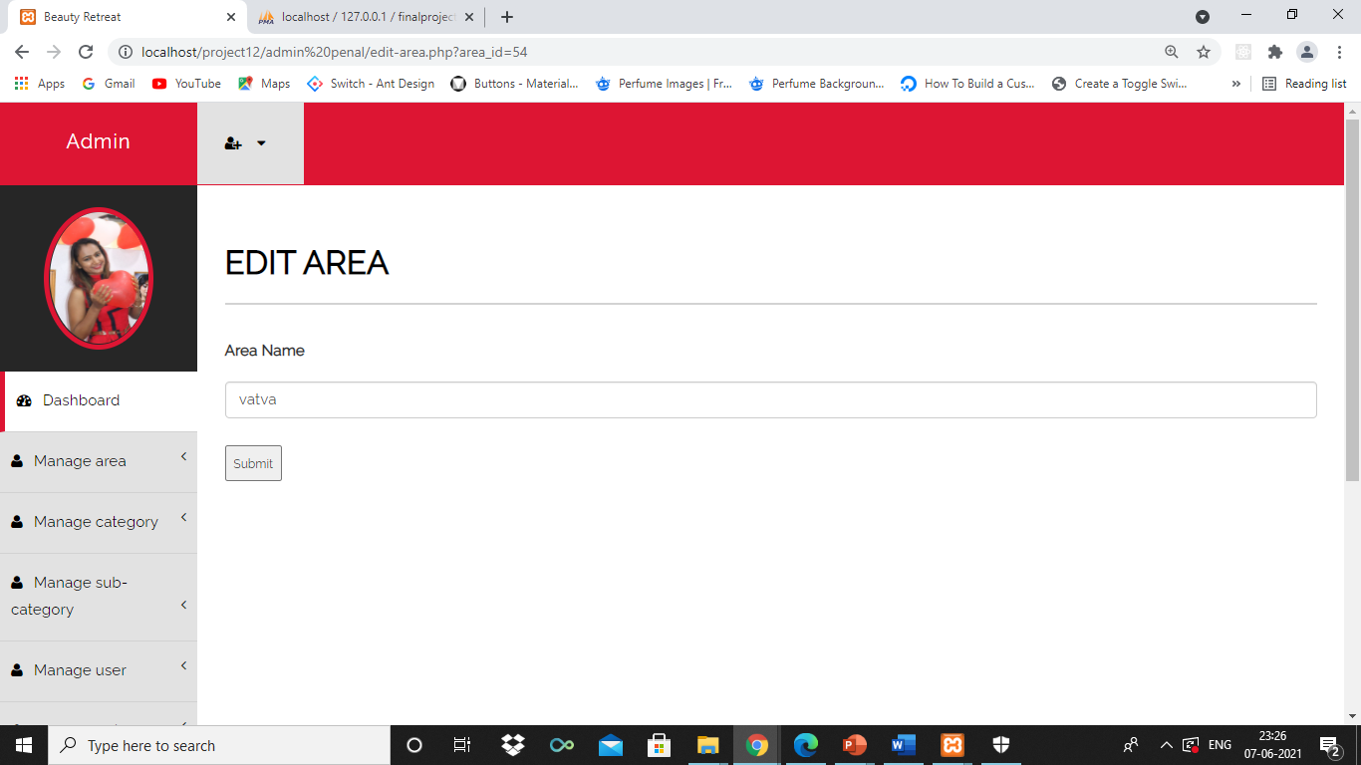
ADMIN INTERFACE:-
Edit Area:-

Slide 83
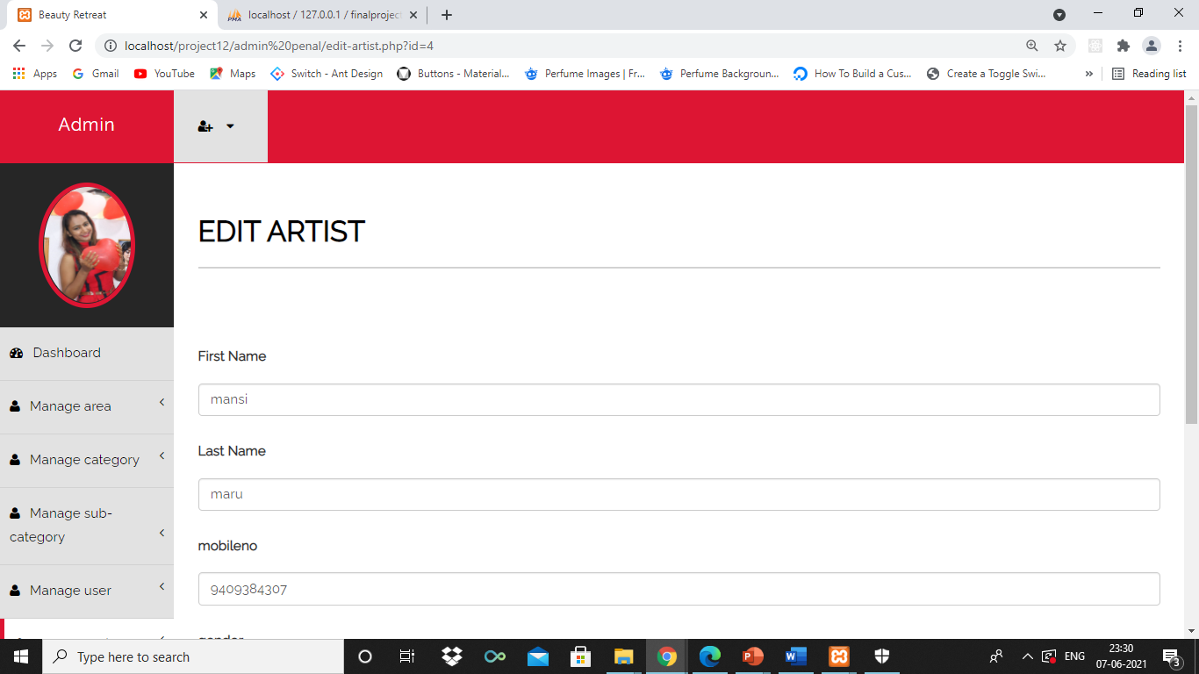
ADMIN INTERFACE:-
Edit Artist:-

Slide 84
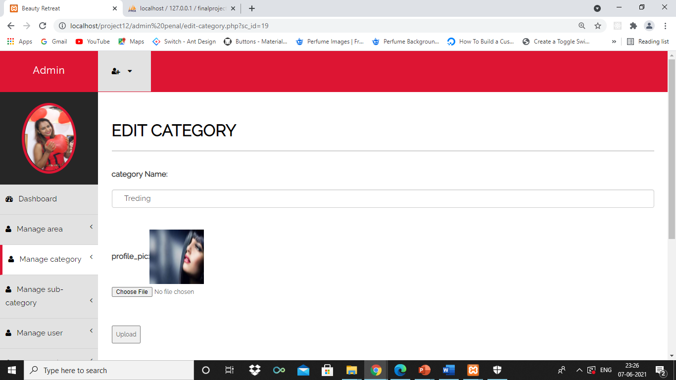
ADMIN INTERFACE:-
Edit Category:-

Slide 85

ADMIN INTERFACE:-
Edit Sub Category:-

Slide 86

ADMIN INTERFACE:-
Edit User:-

Slide 87

ADMIN INTERFACE:-
Edit Profile:-

Slide 88

ADMIN INTERFACE:-
Edit Security Question:-

Slide 89

ADMIN INTERFACE:-
View all User:-

Slide 90

ADMIN INTERFACE:-
View Sub Category:-

Slide 91

ADMIN INTERFACE:-
View Security Question:-

Slide 92

ADMIN INTERFACE:-
View Profile:-

Slide 93

ADMIN INTERFACE:-
View Feedback:-

Slide 94

ADMIN INTERFACE:-
View Contact:-

Slide 95

ADMIN INTERFACE:-
View Complain:-

Slide 96

ADMIN INTERFACE:-
View Category:-

Slide 97

ADMIN INTERFACE:-
View All artist:-

Slide 98

ADMIN INTERFACE:-
View Area:-

Slide 99

ADMIN INTERFACE:-
View order:-

Slide 100
TESTING
ADMIN
ARTIST
USER

Slide 101
ADMIN
Registration
Change password
Add area
Add category
Add Security Question
Email
Security Question
Sub Category

Slide 102
ARTIST
Registration
Email
Login
Login email
Login password
Security question
Forget password
Forget password email
Change password
Add time

Slide 103
USER
Registration
Registration email
Login
Login email
Login verification
Login password
Change password
Forgot password
Retype password
Complain
Complain email
Contact us
Email
Feedback
15. Security question

Slide 104

Admin Testing:-
Registration:-

Slide 105

Admin Testing:-
Email:-

Slide 106

Admin Testing:-
Add area:-

Slide 107

Admin Testing:-
Add category:-

Slide 108

Admin Testing:-
Add question:-

Slide 109

Admin Testing:-
Change password:-

Slide 110

Admin Testing:-
security question:-

Slide 111

Admin Testing:-
Sub category:-

Slide 112

Artist Testing:-
registration:-

Slide 113

Testing:-
Registration email:-

Slide 114

Testing:-
Login email:-

Slide 115

Testing:-
Login:-

Slide 116

Testing:-
Login password:-

Slide 117

Testing:-
Add time:-

Slide 118

Testing:-
Security question:-

Slide 119

Testing:-
Change password

Slide 120

Testing:-
Forget password

Slide 121

Testing:-
Forget password email

Slide 122

User Testing:-
Registration:-

Slide 123

Testing:-
Registration email:-

Slide 124

Testing:-
Login :-

Slide 125

Testing:-
Login email:-

Slide 126

Testing:-
Login verification :-

Slide 127

Testing:-
Login password:-

Slide 128

Testing:-
Retype password :-

Slide 129

Testing:-
Security question:-

Slide 130

Testing:-
Change password:-

Slide 131

Testing:-
Complain :-

Slide 132

Testing:-
Complain email:-

Slide 133

Testing:-
Contact as:-

Slide 134

Testing:-
Email :-

Slide 135

Testing:-
Feedback :-

Slide 136

Testing:-
Forget password:-

Slide 137
summary :-
Assumption:-
The artist and customer must have basic knowledge of computers and online systems.
The Admin should know about the artist or customer requirement.

Slide 138
summary :-
Limitation :-
We do not provide any other languages like Hindi, Guajarati etc.
This website is only visible in Ahmedabad.
Online payment is not possible.

Slide 139
summary :-
Conclusion:-
Updating of information becomes so easier.
It provides a friendly graphical user interface which proves to be better when compared to the existing system.
It gives appropriate access to the authorized users depending on their permissions.
It effectively overcomes the delay in communications between artist and customer.

Slide 140
summary :-
Future scope :-
In future we can provide any other language.
We provide online payment system.
We can provide beauty related video or another information.
We can provide email verification.

Slide 141
Bibliography :-
Software Engineering: A Practitioner’s Approach by R.S. Pressman
www.w3schools.com
www.urbanclub.com

Slide 142
THANK YOU

